Slide 1

Prolonged Loss of the Electric Power Grid
And
Consequences on Your Family
“Want of foresight, unwillingness to act when action would be simple and effective, lack of clear thinking, confusion of counsel until the emergency comes, until self-preservation strikes its jarring gong—these are the features which constitute the endless repetition of history.” - Winston Churchill
BG (Ret) Ken Chrosniak
EMPact America
Notes:
Prior to World War II Winston Churchill brilliantly conveyed his insights to his beloved Britain, which certainly rings true for America at this time. Churchill suffered from a “Cassandra effect” as he was cursed with the prophetic gift of warning for the future but fated not to be believed.
My intent is not to add to your already high level of angst that has pervaded our Homeland with the recent Pandemic furor and tenuous condition in world affairs,- but I believe it’s essential to inform you of the fatal effects of the “failure to imagine” which now shapes the vulnerability your family, community and our Homeland. It’s important to visualize a truly realistic depiction of what the future will hold if we continue down the path of doing nothing, with information that the government certainly does not want you to be aware of. It’s not conspiracy, but fact.
Churchill’s utterings eight decades ago ring especially true today for our Homeland, as we suffer from lack foresight, excessive confusion of counsel, a total unwillingness to act due to the lack of political will and real leadership (at all levels), and certainly the lack of clear thinking, until we come face-to-face with the “jarring gong” of existential threats surrounding us, as when the Shit Hits The Fan (SHTF) it will truly be a “come as you are affair” with no second chance, - no sequel.

Slide 2

Long Term Loss of the Electric Power Grid
EMPACT America is a bipartisan non-profit organization founded by Mr. Henry Schwartz, owner of Steuben Foods in Elma New York, focused on the singular mission of protecting the critical power grid which literally enables sustainment of life and our national sovereignty.
Notes:
EMPACT America is a bipartisan organization of concerned citizens focused on protecting the American power grid. EMPact America is a not-for-profit corporation (with IRS 501(c) 4 status) that recognizes not any threat to our totally unprotected electric power grid from either a hostile Nuclear source, a naturally (and inevitable) Solar flare, Physical or Cyber attack would destroy our critical infrastructures that enables food, water, telecommunications, transportation, banking and finance and everything vital to the sustenance of modern America. Our mission is to ensure their viability and survival of your family and community. For well over a decade EMPact America remains an advocacy organization f which I am extremely honored to be part of Mr. Schwartz's goal to protect the American people through his continuing effort to raise awareness support hardening and protection of our electric grid to avert the prolonged loss of power.
EMPact America and many other organizations have tirelessly conducted numerous lectures, workshops, testimonies to state and federal level elected officials, and dozens of conferences and round table discussions to achieve this goal by focusing efforts to influence and encourage federal and state legislation to protect the citizens from this existential series of threats. This is been a partial success, as after many legislative failures we finally have some movement federal level (absolutely nothing from the states) through two presidential executive orders and congressional National Defense Authorization Act which to date have not resulted in any Protection whatsoever our electric grid.
So, my prime reason for this presentation stems from extreme frustration felt by many of my colleagues that share the same concern Mr. Schwartz has had for well over two decades, is the fact that after all this time, we remain completely susceptible due to vulnerabilities of our aged and overburdened electric power system.
This presentation is as close as possible to an in-person experience to reach you, and hopefully a larger audience, and I pray that it is sensible and informative for you to examine at your leisure and to pass on to many others.
The goal is simple: that upon completion you’ll forward it to others to raise their awareness of current, and ongoing, threats surrounding us which the government and the electric industry have failed to inform citizens of, and in which they have been incapable of protecting you from. Washington and all 50 States are completely dysfunctional on this critical issue and have been for decades through infighting, lack of leadership, and the “fatal failure to imagine.”
Included at the end is the obligatory BIO. Also, it’s especially important in all my presentations that I take time for Q&A, - so I’ve provided my email address on the last slide. I’m thick-skinned most of the time, and I believe I still have possibly 2 lives left of my original 9, – so please feel free to critique/add comments, as I will do my best to respond.
TIME is of the essence, which we do not have, – so let's get started.

Slide 3
Before we begin, – a few parameters
This presentation is strictly developed from the perspective of a long-term grid down scenario.
It is not intended to apply to grid down events that can be resolved in less than a week, or two.
It has been developed from the perspective that the event is sudden, and no last second planning was available.
It is developed within our current position of readiness, and not taking into account a hardened grid in the future.
Courtesy of Jonathan Hollerman
Notes:
Right up front I need to impress upon you that I’m not here to discuss what I term ‘normal’ disasters that our Homeland experiences multiple times a year from tornado’s, floods, hurricanes and other disasters which are routinely dealt with very efficiently by local 1st Responders, State Emergency Managers, FEMA and even our military, when necessary, – but rather to focus you on threat vectors that are capable at this present time, of initiating catastrophic degradation or destruction of life-sustaining electric power for several weeks, months, or longer.
I know it looks like a tremendous number of slides, as normally I usually present this information using about 15 slides or less for in-person presentations of normally an hour. But due to Pandemic difficulties, myself and many of my colleagues in this fight have not been able to present in-person, as we now resorted to ZOOM discussions which basically result in talking amongst ourselves. I want to provide you with crucial information which I am assured that neither your government, or especially the electric industry, has informed you of.

Slide 4
“It was the best of times, it was the worst of times, it was the age of wisdom, it was the age of foolishness, it was the epoch of belief, it was the epoch of incredulity, it was the season of Light, it was the season of Darkness, it was the spring of hope, it was the winter of despair …, we had nothing before us, we were all going direct to Heaven, we were all going direct the other way …” -- Charles Dickins, “A Tale of Two Cities”
“We are on Life Support”
-- CSM (Ret) Michael Mabee
Notes:
Charles Dickins perfectly describes our present age of extreme opposites of chaos, conflicts, and despair, – as well as occasional happiness.
Command Sergeant Major (Ret, Army) Michael Mabee served combat tours in Iraq and Afghanistan, humanitarian missions to Guatemala, and just recently endured the Winter Storm fiasco/debacle in Texas. He is a subject matter expert on threats to your weak and exposed electric power grid.
I agree with him that our Nation is on life support, but I envision that we all are in an Intensive Care Unit where our lives are totally dependent on a ventilator run electricity, - which is powered through an aged, vulnerable and self-regulated electric industry, - who for decades have been aware of their weaknesses but have done absolutely nothing to ensure we have sustainable electric power from any threat level.

Slide 5
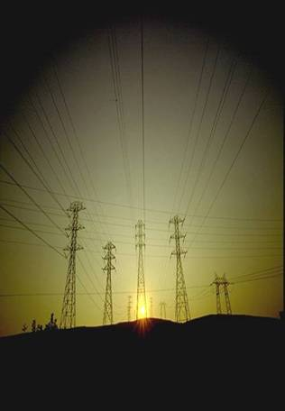

BLUF:
CLEAR AND PRESENT DANGER
TRUTHS: - You can’t sell disaster readiness, - can’t scare people and businesses to act..
- Citizens must be informed of the condition of their community and Homeland.
- People most are frightened when they sense their vulnerability to threats, but feel powerless
- People will band together in mutual support; - to a point.
Our nation is not prepared to survive
- While we so far have the best offensive military in the world, we have the worst defense of our own Homeland at the Catastrophic level.
- If you say you plan for All Hazard’s, - then do it!
- ALWAYS, ALWAYS PLAN FOR THE WORST-CASE SITUATION
WE SUFFER FROM A FAILURE TO IMAGINE
Notes:
The Bottom-Line Up Front.
I learned over many in-person presentations that that you cannot scare people to action, as in many respects this threat is truly overwhelming. So I try to impress upon them the fact that while this information seems overwhelming now, - just think how overwhelming your situation will be if you do nothing, and an extensive and prolonged loss of electric power of only a few weeks will have a catastrophic economic and human cost for the Homeland.

Slide 6
KNOWN’s & REALITIES
KNOWN’S:
- THREATS are well documented, some ongoing
- VULNERABILITIES are known to your leaders, the enemy, and should be to you also
- RISKS are known long time ago with 2004/2008/2017 EMP Commission reports, Defense Science Board, NOAA/NASA, Federal Electric Reliability Commission, National Academy of Sciences, White House Science Advisor, Lloyd’s of London, DHS, DOE, DoD, National Laboratories…..
- Protective hardware and technologies are known/doable: cost can readily be absorbed by power industry for negligible cost per year to consumer
REALITIES:
- No substantive actions to date from Power Utilities, DHS, DOE to protect life sustaining Energy and Communications
- POTUS Executive Order and Multiple National Defense Authorization Acts (NDAA) have essentially been ignored by federal agencies
- The time is out for more studies
Proceed with a Sense of Urgency: go with the 80% Solution
Multiple threat vectors as never before
TIME is of the essence
-- TO BE HONEST, THE UGLIEST REALITY IS THAT YOUR GOVERNMENT AT ALL LEVELS IS NEUTERED, AND CANNOT PROTECT YOU AS THERE IS NO PLAN.
-- YOUR VOICE AND ACTION ARE DESPERATELY NEEDED
Notes:
THE OBNOXIOUS REALITY IS THAT YOUR GOVERNMENT AT ALL LEVELS IS NEUTERED AND HAS FAILED TO PROTECT YOU. WE DESPERATELY NEED THE POWER OF YOUR VOICE AND ACTION.
SAYING THAT, WE ARE APPEALING TO YOU, THE PRIVATE CITIZEN, AS THE RESPONSIBILITY IS YOURS TO INITIATE ACTION FROM THE BOTTOM-UP, AS YOUR LOVED ONE’S AND COMMUNITY WILL BE THE FIRST TO EXPERIENCE UP CLOSE AND PERSONAL THE SHOCK OF SURVIVAL WITHOUT ELECTRIC POWER FFOR A PROLONGED PERIOD.
POTUS: President of the United States
DHS: Department of Homeland Security
DOE: Department of Energy
DoD: Department of Defense
NOAA: National Oceanic and Atmospheric Administration
NASA: National Aeronautics and Space Administration

Slide 7
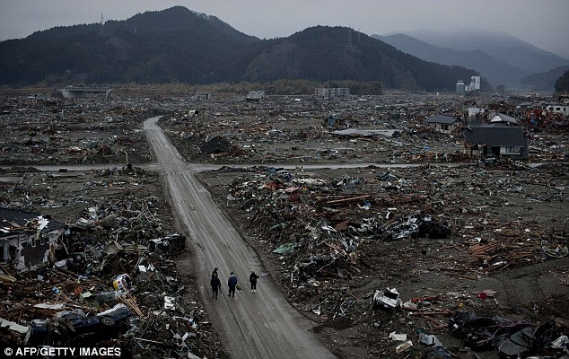
Aneyoshi, Iwate Prefecture - 11 March 2011 Tsunami
Were they warned?
Notes:
Here’s a classic example of a “failure to imagine” which was perfectly illustrated well before the tsunami that devastated Fukushima Japan in 2011.
So, the question is “were the people in that area of Japan warned of the possibility of such an event?”

Slide 8
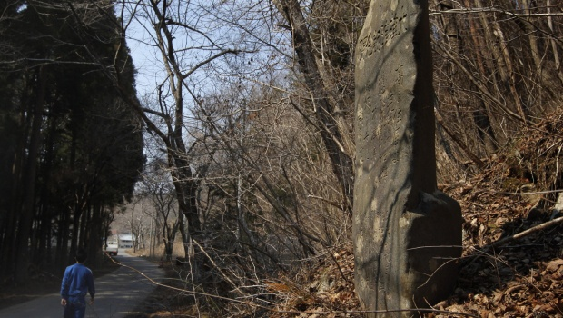
YES, they were warned!
Marker reads, “High dwellings are the peace and harmony of our descendants… Remember the calamity of the great tsunamis. Do not build any homes below this point.”
Those siting the reactors at Fukushima, and village for that matter, ignored these stone markers.
Notes:
Of course, they were, as there are centuries-old stone tablets, 4-10-foot-high (nearly 300 of them) with some more than 600 years old sited along the Japanese coast warning of prior tsunamis near devastated towns like Aneyoshi.
After the tsunami flooded over 5 hundred square kilometers of the Japanese coast, it was discovered that those siting the reactors at Fukushima ignored these stone markers that had for centuries warned against building anything below the high-water mark of previous tsunamis.
That unheeded warning cost over 19,000 lives and incalculable sums, and the price in both only increased as a result of the difficulties associated with trying to contain the leaking radiation in ground water under the stricken plant. Seawater is sure to flood the same areas again when, not if, future earthquakes trigger additional tsunamis.
This tragedy was heralded by the lack of real leadership, or foresight and imagination of planners and organizations, – disconcertingly like what's going on in our Homeland right now and has been for decades.
Unfortunately, we are now facing a potential disaster that could make Japan’s Fukushima nightmare look like a day at the beach (no pun intended). And, as with the Japanese, – we have been warned.

Slide 9
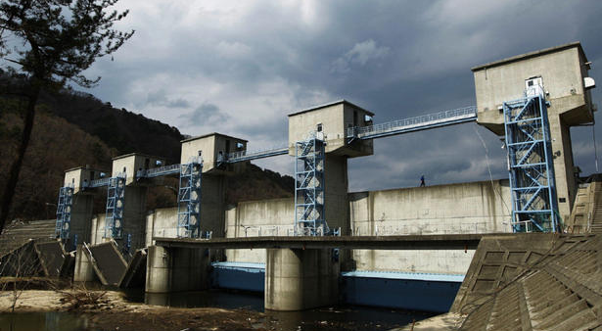

Mayor Kotaku Wamura of Fudai City Japan, is built a 51-foot floodgate and seawall in the 1970s. It took 12 years to complete, and with a lot of skepticism. During the Mar 11, 2011 earthquake and tsunami, the floodgate was closed, saving all 3,000 residents and houses. Without this floodgate the city certainly would have been destroyed. Wamura died in 1987 at the age of 88.
At his retirement, Wamura stood before village employees to bid farewell: “Even if you encounter opposition, have conviction and finish what you start. In the end, people will understand.”
Notes:
Here’s an example of what true leadership really looks like, - which we’re severely lacking in America at the present time at all levels of government.
Thank God there was one village leader who did not suffer from a “failure to imagine” as he had experienced tsunamis as a child and passionately planned to save his village because he had the foresight and common sense to plan for the worst-case situation!

Slide 10

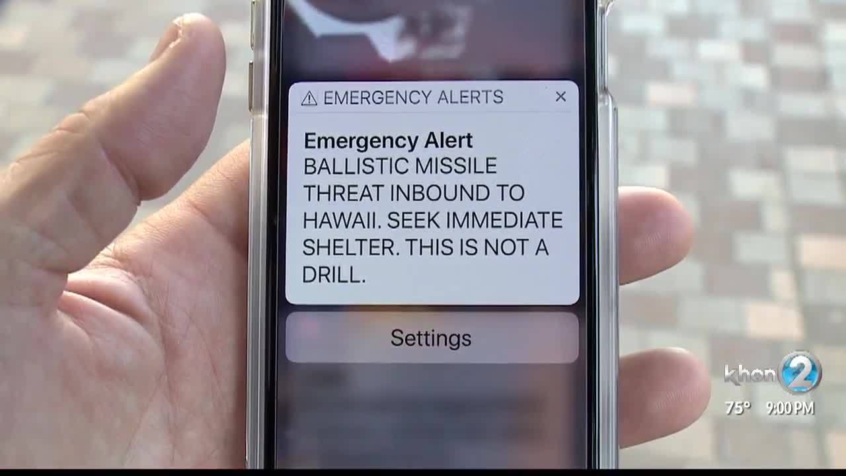
8:07 a.m. 13 January 2018
It’s amazing, as nobody knew what to do!
Demonstrates that the Homeland is not ready for a catastrophic– cataclysmic
level disaster as we can't even advise or protect at the individual or community level.
Notes:
Another fine example of a “failure to imagine” occurred several years later when citizens of Hawaii were awakened to an alarming and unbearable situation, when they were told to seek shelter immediately as Intercontinental Ballistic Missiles were on the way (presumably from North Korea).
It would be an understatement to say that they were terrified and panicked, producing a chaotic ‘ecstasy-of-fumbling’ where citizens did what they could, even choosing to lower their children in a storm drain for a measure of protection.
But here’s the real issue, - prior to this errant message absolutely no one from the federal or state government had the presence of mind to “imagine” such an event and prepare citizens and communities for such an attack, which any worthwhile leader could envision as probable, especially with the threat level from N. Korea that was all over the news at that time (and should be still). The problem is exacerbated by the fact that any semblance of Civil Defense preparedness, which was extremely effective during the Cold War, has unfortunately been discarded as it morphed into Emergency Management, along with the quantitative analysis and deceits of Risk Management.

Slide 11
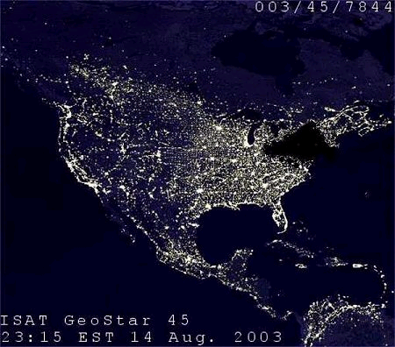
August 14, 2003 Blackout…
FRAGILE
“Tree Branches”
…triggered by a tree branch touched by overheated high voltage transmission line near Dayton, Ohio; further exacerbated by a ‘bug’ in First Energy’s Unix-based XA/21 energy management system control room alarm system in Ohio, causing further cascading effects
AFFECTED:
- 508 generating units
- 256 power plants
- 22 nuclear reactors
- 11 deaths
Notes:
And just how fragile do you think your electric grids is right now? Here’s an example of how negligence by an electric company by not ensuring vegetation control under high-voltage transmission lines (just to save a buck) resulted in tree branches touching a heated and sagging overhead high voltage transmission line. Immediately afterwards in the control room a software bug within the alarm system failed to alert system operators of the malfunction, in which they were deprived of crucial audio and visual alerts for important changes in system state to initiate corrective action. The following ‘ecstasy of fumbling’ (my favorite term) resulted in devastating cascading effects (you should remember this term) across 600 miles, thru eight states and Canada, resulting in a blackout.
Most tragically, it resulted in 11 deaths. It’s interesting to note that the Northern Electric Reliability Corporation (NERC) is responsible for ensuring safety of the bulk electric system, then took 10 years to produce a Critical Infrastructure Protection (CIP) procedure for tree trimming. I know, amazing isn’t it!

Slide 12
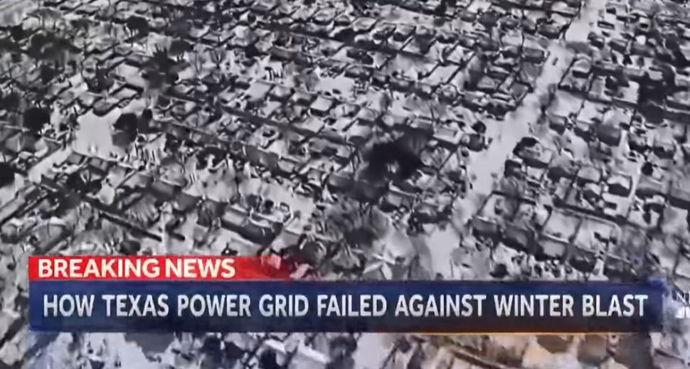
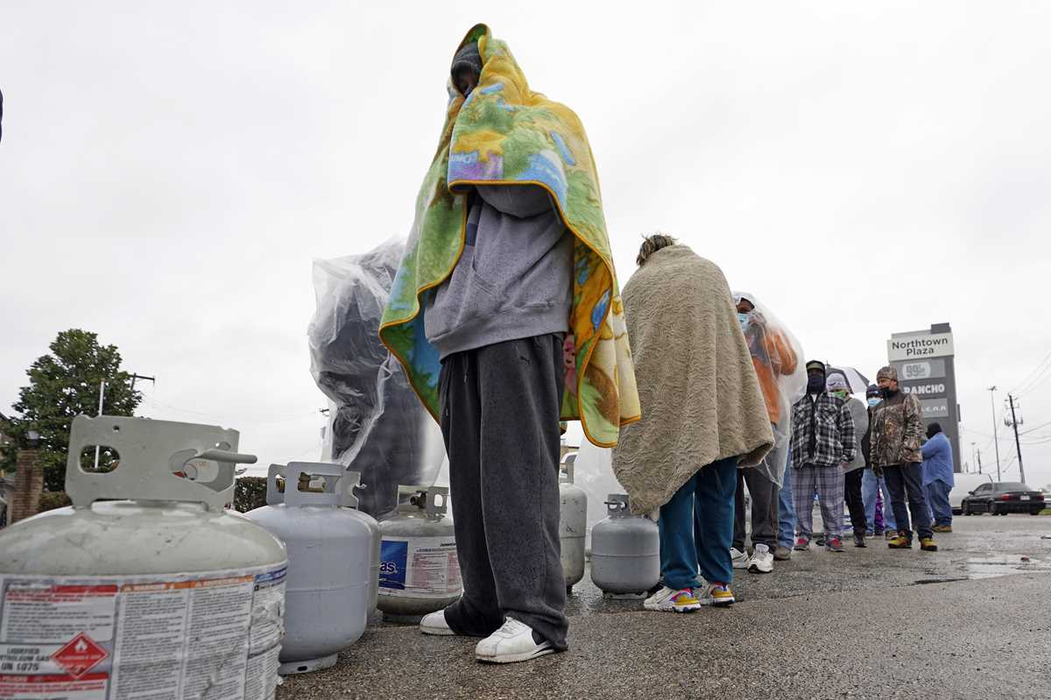
Texas Winter weather blackouts occurred in February 2021, just as they did in 1989 and 2011!
Each of them brought to you by the Electric Reliability Corporation of Texas.
It is only after a significant harmful event has occurred that we, as a society, raise questions as to why didn't we do more to guard against the potential effects.
It seems it has always been that way.
Notes:
Bear with me as I throw in one more farce for good measure, as a prime example of a conceivable future catastrophic level event.
The Texas winter storm fiasco, exacerbated by the Electric Reliability Corporation of Texas (ERCOT) rightfully proves again a deadly case of a “failure to imagine” combined with pure unadulterated negligence, - especially egregious after two prior Winter weather blackouts occurred in 2011 and 2018!
This High-Impact/Low-Frequency storm of extreme low temperatures and snow, developed failure among power generation utilities to maintain sufficient frequency, resulting in an ecstasy of fumbling and subsequently resorting to ‘shedding load’ thereby cutting power to millions. It came down to minutes, - about 4 ½ minutes, when the Texas grid would have been devastatingly shut down probably for many months or longer, – and conceivably affecting the Eastern and Western grids. Over 4.5 million homes and businesses suffered, with 210 lives needlessly lost.
There’s much blame to go around for Wind, Coal, Nuclear, Solar and Natural Gas generation.
Managing the electric grid is certainly complex, but it isn’t rocket science folks. Just basic Observation of the problem set (freak Winter storms do happen); Orientation of the problem set (to winterize; make the Decision with tactics, techniques and procedures measures available to fix the problem; and then Act on the decision to ensure this never happens again.
But, - it will surely happen again!
A recent posting from Michael Mabee says that all as Pacific Gas & Electric (PG&E) “was convicted of 85 felony counts for the deaths in the 2018 Camp Fire that destroyed Paradise California. Who is going to be held accountable for the 210 deaths in the preventable Texas grid collapse of February 2021? Spoiler alert: Nobody.”
At least remove the word “Reliability” from the ERCOT. It’s embarrassing.

Slide 13
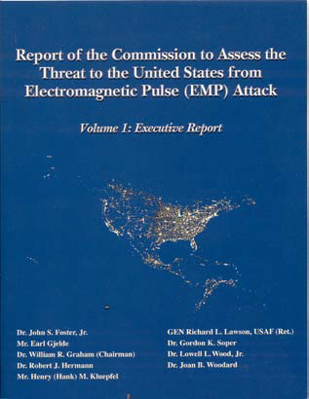
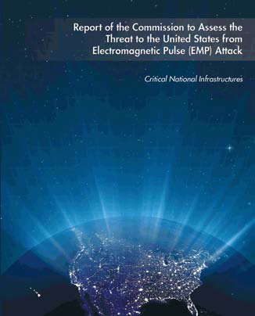
2004
WE HAVE ALSO BEEN WARNED
As we continue suffer from a
FAILURE TO IMAGINE
and Lack of Leadership
2008
Since the definitive 2008 Congressional EMP report, there have been no substantive plans in place right now from the president, congress, power industry, DHS, DOE, FEMA, USFA, DoD, regional, state, local, tribal entities…, that have even started to effectively deal with any high-impact threats and hazards to the electric power grid
Notes:
Congress established an EMP Commission in 2001 to research and identify any steps it believes should be taken to protect its military and civilian systems from a high-altitude Nuclear Electromagnetic Pulse attack in our atmosphere. The Commission produced reports in 2004, 2008 and several in 2017 before they were permanently (and unfortunately) disbanded.
A perplexing problem exists in that the Department of Defense has spent billions of dollars to harden communications and varied assets to withstand an EMP pulse from the Sun or a manmade Nuclear attack, – but nothing whatsoever has been forthcoming to ensure the operation of the civilian electric power systems that not only supports our civilian infrastructure, but also 99% of the military structure.
An excellent summary from the 2008 EMP Commission would make a great science fiction movie, but it’s actual reality:
“The electromagnetic pulse (EMP) generated by a high-altitude nuclear explosion is one of a small number of threats that can hold our society at risk of catastrophic consequences…A single EMP attack may seriously degrade or shut down a large part of the electric power grid in the geographic area of EMP exposure effective instantaneously. There is also the possibility of functional collapse of grids beyond the exposed one, as electrical effects propagate from one region to another…Should significant parts of the electric power infrastructure be lost for any substantial period of time, the Commission believes that the consequences are likely to be catastrophic, and many people may ultimately die for lack of the basic elements necessary to sustain life in dense urban and suburban communities.”
Rule #1: always plan for the worst-case situation.

Slide 14

PLANNING LEVELS
DESIGN-BASED
BEYOND DESIGN-BASE
EVENT
DISASTER
CATASTROPHIC
CATACLYSMIC
TRAGEDY
Notes:
Before we go any further, I need to explain my assessment of event levels that the DoD and FEMA should plan for and exercise.
As stated earlier our Homeland frequently encounters events that affects delivery of electric power which I term Design-Base Events, and it’s well-known by all Americans that DHS, FEMA, and the DoD are exceptionally proficient and well-organized for rapid response and recovery for events such as wildfires in California; hurricanes; floods; earthquakes, tornadoes and so on. These threats are termed High-Impact/High-Frequency (HI/HF) events which, while devastating, can be dealt with in days or possibly a few weeks, as outside sources of help are assured.
They are important, but I’m focused solely on the totally neglected and more intensely devastating threat scenarios that I’m confident you have not been informed of, that are significantly more challenging. These are called Beyond Design-Base Events (BDBE) which can be Man-made such as a High-Altitude Nuclear Electromagnetic Pulse (HEMP) detonation, Physical attacks, Cyber attack, Remote Frequency attack, – or Naturally, with the inevitable Solar induced Geomagnetic Induced Currents, an earthquake (New Madrid fault) or Pandemic to name a few. The most appropriate term for these threats is High-Impact/Low-Frequency (HI/LF) events.
A number of emergency planners consider manmade HI/LF threats as theoretical, but they should still be planned for as ALL HAZARDS,- which they are not at this time. All levels require differing policies, plans, scenarios and exercises for operations in Urban, Suburban or Rural areas (or all three simultaneously). Here’s a hint for doubting-Thomas planners: any Long-Term Power Outage will not bode well for survival in all three areas, but especially so in Urban neighborhoods. From the gifted mind of brilliant psychologist and writer Dr. Charles Krauthammer, “When the comfortable encounter the unimaginable, the result is not only emotional, but also cognitive rejection.” The measure of your denial will directly determine the degree of personal heartbreak and calamity that you will encounter .
My bottom line: While we have extensive and well proven plans for all Design-Base Events, we have absolutely zero plans for Beyond Design-Base Events from DHS/FEMA/DoD, the Nuclear Regulatory Commission (NRC) and all federal and state agencies.
---------------------------------------------------------------------
DoD: Department of Defense FEMA: Federal Emergency Management Administration DHS: Department of Homeland Security

Slide 15
Catastrophic Power Outage
An event beyond modern experience that exhausts or exceeds mutual aid capabilities
Likely to be a no-notice or limited-notice event that could be complicated by a cyber-physical attack
Long duration, lasting several weeks to months due to physical infrastructure damage
Affects a broad geographic area, covering multiple states or regions and affecting tens of millions of people
Causes severe cascading impacts that force critical sectors— drinking water and wastewater systems, communications, transportation, healthcare, and financial services—to operate in a degraded state
NIAC: The President's National Infrastructure Advisory Council
Notes:
So, my focus is on the Catastrophic level as it will be momentous and violent, marked by overwhelming upheaval and destruction that brings great changes which can, over a compressed timeframe, intensely bear on survivability.
There will be no distinct lines of separation when entering the Catastrophic Beyond Design-Base level as it depends on the measure of cascading effects on all 16 Critical Infrastructures (CI) eventually encompassing even further large-scale and severe devastation of military and civilian organizations, initiating further tremendous damage at the national-level, along with accompanying unimaginable loss of life.
The Apocalyptic approaching Tragedy are totally unknown levels, that will most likely result in the complete loss of national sovereignty and the ability to defend the Nation, - in which the Tragedy level may prove irreversible.

Slide 16
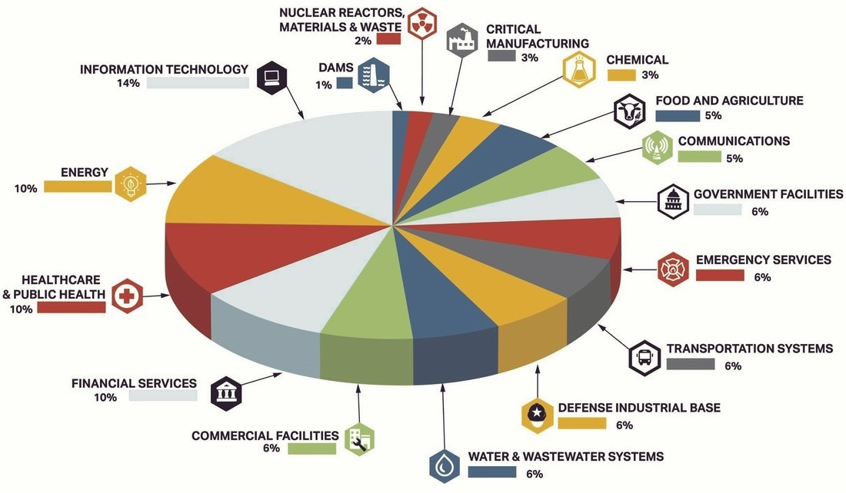
16 CRITICAL INFRASTRUCTURES SECTORS & INTERDEPENDENCIES
Notes:
So here are all 16 Critical Infrastructures (CI) that enable the health, wealth, and security that your family relies on daily by producing and distributing goods and services extending across a huge array of physical assets, processes and organizations. All are vital (but some more than others) as disruption to their function will have a cascading effect, domino effect if you like, impact on other CI’s and lives.
Without a doubt, I consider Energy as the most critical, as all remaining CIs depend on Energy/Electricity to function. If electricity is disrupted or destroyed for even a short period time, all remaining CI’s will be affected via Cascading Effects.
If power is unavailable for a prolonged period, millions will die. It’s that simple.

Slide 17
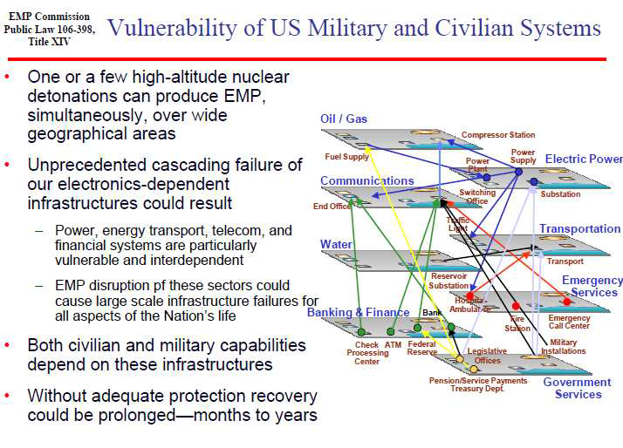

Notes:
This slide, from the 2008 EMP Commission provides a clear picture of just how easily cascading effects will occur, leading up to the Catastrophic level and beyond, producing a prolonged electric grid outage.
All 16 interconnected Critical Infrastructures form a "system of systems" in which the failure of one or many can further cascade and upset the stability of the entire system, and ultimately manifest itself in numerous areas dependent TIME in days or weeks. It should be very obvious that your Military and FEMA are totally dependent upon the same civilian electric grid that you are, and every single aspect of human life is utterly reliant on electricity.

Slide 18
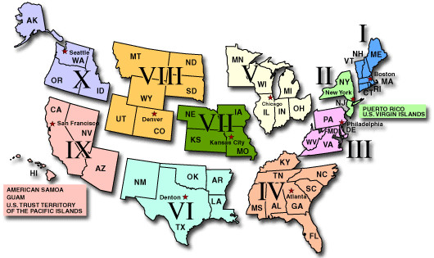
Federal Emergency Management Administration (FEMA)
FEMA’s underlying message has not changed in the last two administrations: survival is a local issue. This is especially true when we undergo a national-scale catastrophe. But if we are to prepare for a “worst-case scenario” this message means we need local government and communities to be capable of self resilience for long periods – weeks or months – when no outside assistance is available.
Notes:
It's well known that FEMA is great at disaster preparation, response, and to facilitate an initial degree recovery The agency is broken down into 10 regions covering all states and territories. When the level of destruction increases in magnitude or area of coverage, additional FEMA regions collaborate and mutually support one another as needed – but is only effective if there are established policies, plans, scenarios, and exercises to maintain relationships and proficiency. That’s what’s lacking for BDBE!
Well, here’s another timely Churchillian ”jarring gong” from past FEMA Director Brock Long in 2017 noted by Michael Mabee:
“Our emergency management system depends on the ability to bring in outside resources when the event overwhelms local capabilities. Federal, state and local governments do not drill for this. There is no government plan to respond to this type of event. There is no legislation requiring that the grid be hardened against these known threats.”
How is this going to work out for you if several to nearly all 10 FEMA regions are simultaneously engaged in rescue and recovery, without assets or personnel available to assist other FEMA regions? Hint: Planning worst-case, – you will be on your own.

Slide 19
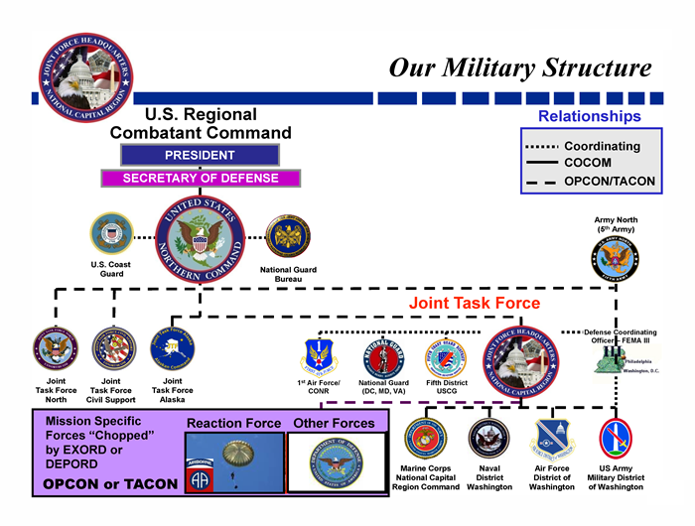
Notes:
As a result of the 9/11 attacks U.S. Northern Command (USNORTHCOM) was established in 2003 to provide command and control of Department of Defense (DOD) Homeland defense efforts, and coordinate Defense Support of Civil Authorities (DSCA). I remember it well as I was a J4 (Logistics) staff officer on the Joint Chiefs of Staff (during my first retiree recall to active duty) as Liaison Officer between the Logistics and J5 Plans directorate, as we developed its structure. NORTHCOM includes embedded Liaison Officers to work with each regional FEMA office to partner across all levels of government, non-governmental organizations (NGO), and the private sector to quickly respond, rescue and assist in initial recovery. NORTHCOM has few permanently assigned forces as they rely on each military service ante-up personnel and equipment when activated. Deeply tied to FEMA regions, NORTHCOM’s civil support mission includes domestic disaster relief operations that occur during fires, hurricanes, floods and earthquakes, and the command supports FEMA as needed.
Mmilitary facilities and defense systems built EMP protection into their facilities and weapon systems, to what degree is unknown, over the decades of the Cold War, which certainly affects the capabilities at the Strategic level to perform. However, critical energy generation, transmission, distribution and control remains 100% within the vulnerable and undefended civil infrastructure.
My bottom line: FEMA and NORTHCOM are not prepared for sustained response to a prolonged electric grid outage encompassing all Critical Infrastructures simultaneously. They have no substantive on the shelf policies, plans, or scenarios for a BDBE.

Slide 20
Basics of our Linked U.S. Power Grid
“It would be hard to intentionally design an electrical delivery system more vulnerable and fragile than now.”
-- Ambassador R. James Woolsey, Past CIA Director
Notes:
“It would be hard to intentionally design an electrical delivery system more vulnerable and fragile than now.” -- Ambassador R. James Woolsey, Former CIA Director
The next few slides will acquaint you with some very basics elements of the electric power grid to give you an appreciation not only of the complexity of running such a huge system-of-systems, but also of its extreme vulnerabilities. As shown, there are three distinct bulk electric power grids that makes up our nationwide interconnected systems.
It's important to remember right up front that the grid was never built for security, it was built to supply assured electric power to customers, and to make money. It’s essentially a loosely connected league of over 1,400 independent (or semi-dependent) organizations with policy and oversight by the Federal Electric Reliability Commission (FERC), the Nuclear Regulatory Commission (NRC) including state regulatory organizations. The North Electric Reliability Corporation (NERC) acts as the FERC's operational arm which devises standards to be used by all electric industry. Additionally, there are public utility commissions in all states.

Slide 21
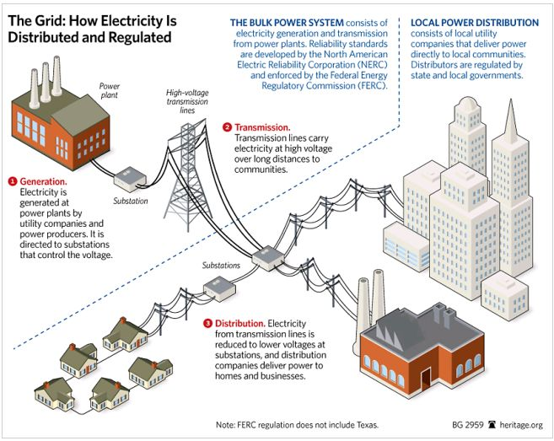
Notes:
Each grid Generates, Transmits, Distributes and Controls the flow of electric power.
As shown, grids are separated into two areas (indicated by the broken/dashed lines) which separates the Bulk Power System of Generation and Transmission, - and the Distribution system that delivers electricity to your home or business In which each exhibits its own set of distinct vulnerabilities.
And importantly the overall command and control system, using ubiquitous Supervisory Control and Data Acquisition (SCADA) systems, maintain control of nearly every function of grid operation from generation to user.
SCADA systems eliminate the need for manual operations to switch relays across the grid physically, allowing the system to be monitored almost exclusively from afar.
In order for electricity to get from generation to users it must be transmitted over long distances, where its voltage is increased (stepped-up) at from the generation site by Extra High Voltage transformers (EHV), and then decreased (stepped-down) by other EHV transformers near your home or business. Without EHV’s the grid will certainly cease to function. But here’s the rub: the balance of electric power from generation to You (the essential demand load) requires perfectly balanced voltage levels at all times and must harmonized perfectly at a constant 60 hertz. Lastly, remember that the grid was never designed for security against a manmade or natural threat event, as it remains even more fragile and vulnerable than ever with the initiation of the Smart Grid adding to the load required requiring immense generation capability.

Slide 22
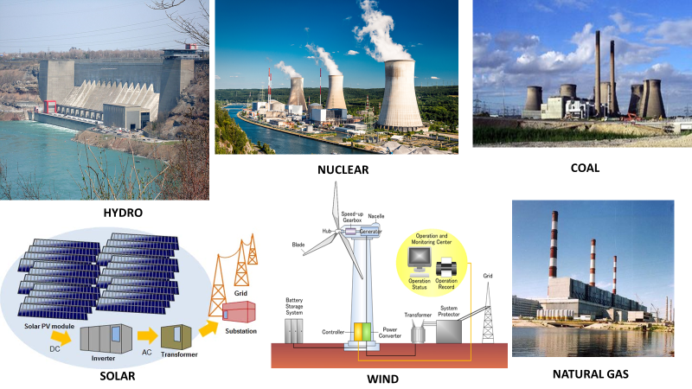
Power Generation
Notes:
The power grid starts at Generation that was, at one time, only generated at central power stations by coal, natural gas, nuclear or hydroelectric power. Today, additional energy generation resources are available with renewable solar and wind. Not shown are Biofuel, Geothermic, Ocean (Wave, Tidal, Current, Thermal).

Slide 23
Ultra HV: >765kV
Extra HV: 345, 500, 765
High V: 115, 138, 161, 230
Med V: 34, 46, 69
Low V: <34
Voltage Transformers
Source: Courtesy of Pauwels Canada, Inc., 2003.
Notes:
Electricity flows out of step-up transformers at the high-voltage levels needed to move power over long-distance lines. Then transformers on the other end step down the voltage for delivery to homes and businesses. They're the electrical equivalent of on- and off-ramps to major highways.
When a transformer goes off-line, its electrical load is diverted to adjacent units, which bear the increased load until the transformer can be reactivated, but, this time, so many are disabled that too much power is diverted. The sudden influx overloads adjacent transformers, knocking them out as well. Transformers fall like dominoes, and soon the entire grid succumbs to a massive cascading blackout. Because the transformers are broken and not just switched off, they must be physically replaced or repaired, - processes that can take between six and eighteen months.
Electric “pressure” is measured in volts, as transformers are measured in 1,000 Volts (1kV) that are typically at or above 110 kV, with some as high as 765 kV. These EHV Transformers, ~2,100 of them (most 345kV and above) are the backbone of the grid.
Our concern is that the simultaneous loss of multiple transformers, especially the vulnerable 300, will affect the capability of a regional network to reroute power through secondary lines while maintaining the critical frequency of 60 Hertz (Hz). They are huge, likely hundreds of tons, labor-intensive and take 12 to 24 months to manufacture and deliver on-site, with extremely few replacements and spares available from the electric power companies. It’s well known, especially by our enemies, that disabling as few as 9 strategic large transformer substations during a time of peak electricity demand could cause a “coast-to-coast blackout” over an extended timeframe. Were you aware of this already? Are you surprised that no one told you about this extreme vulnerability? I’d like to think that the recent Texas Winter storm regional fiasco attests to the degree of vulnerability.
While it’s true that not all industry experts agree on the potential severity and duration of a blackout from multi-transformer damage, it sort of reminds me of the way of thinking when planners decided to build a Nuclear Power Plant site at Fukushima. But electric industry experts generally accept that severe outages may be technically possible. But then again, - they don’t know! But hopefully insurance providers such as Lloyds's Of London and Moody are aware!
My bottom line: As of now those that have the means to correct this problem-set suffer from a fatalistic “failure to imagine” the worst-case situation, which should be important as the lives of YOUR family depend upon sustained electric power.

Slide 24
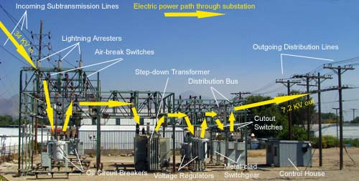
Notes:
Substations are part of an electrical transmission system that transforms voltage from high to low, or the reverse. Switching Stations ties two or more electric circuits together through switches to permit a circuit to be disconnected, or to change the electric connection between circuits. These are the critical Step-up or Step-down transformers sites seen everywhere along most highways.
As you can see, the only protection is a chain-link fence, and certainly open to physical engagement even by novices. Most are unmanned field sites, many (unfortunately) with Internet access for control.

Slide 25
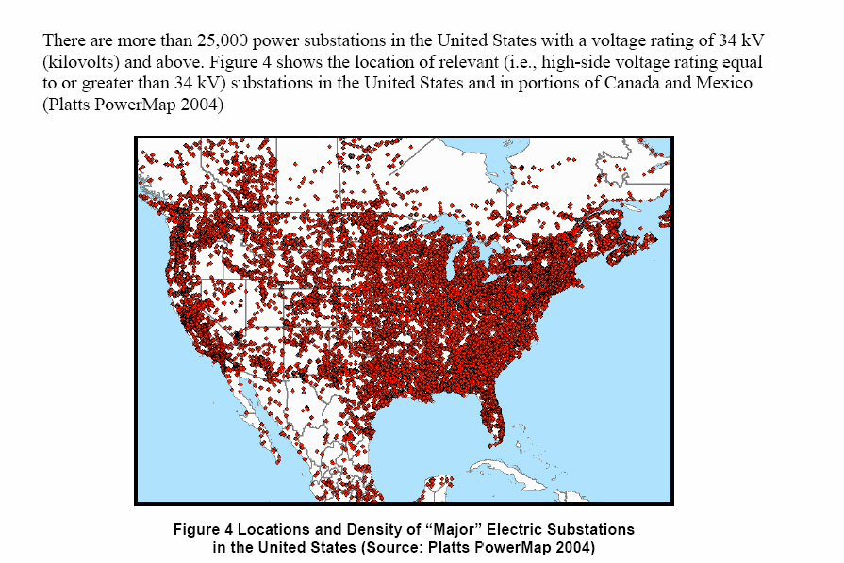
Notes:
Our total grid is certainly the world’s largest machine thousands of power substations and an enormous array of high and lower voltage elements all across the nation. Our electric power system has evolved into an overly complex operation of well over 3,300 utilities, with about 9,000 generating units that work together to deliver your power. Supporting this system are ~200,000 miles of high-voltage transmission lines, 55,000 substations and 5.5 million miles of distribution lines that bring power to millions of homes and businesses. This is what I call a ‘target rich environment.’

Slide 26
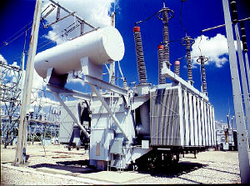
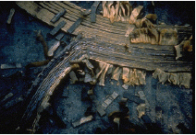
2008 EMP
Commission
Vulnerability of U.S. Electric Power Transformer Infrastructure
EMP induced functional collapse of the electrical power grid risks the continued existence of U.S. civil society.
  - Late time EMP could induce currents that create damage throughout the grid.
- National electrical grid not designed to withstand widespread simultaneous collapse.
- Grid designed for efficiency and profit, – not security or resiliency.
- Average age of most EHV is ~40 years.
- Procedures do not exist to perform “black start” power generation.
  - Any restart of the grid would depend on telecommunications and fuel transport, which depend on electricity.
- Restoration will take months-years as transformer are ‘custom tailored’ for specific sites grid. Not interchangeable.
  - Electric industry Transformer Spares amount is ~ 5%.
  - Manufacturing for most transformers are not from the United States.
  - Average normal delivery time 12 to 18 months.
  - Extremely detailed logistics preparation for transportation, and site emplacement.
Melted 500kV transformer
coil from Salem Nuclear Plant after 1989 Quebec Solar geomagnetic disturbance
Sustained Electric power is key to a functioning society and military.
EMP induced destruction of power grid components will substantially delay recovery.
Notes:
The electric industry maintains a EHV transformer spares program of ~5% replacement availability, which is insufficient not only in numbers, but also that each transformer is specifically manufactured to exact customer's specifications for precise placement within the grid, - certainly are not one-size-fits-all. Maintaining large spare inventory would be unfeasibly expensive and extensive.
We’ll touch more on this with some upcoming slides.

Slide 27

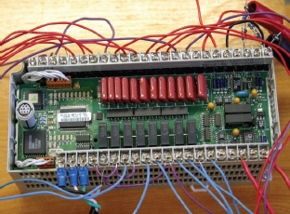
EMP
Commission
Supervisory Control and Data Acquisition (SCADA)
Ubiquitous robots of modern civilization
  Process control: water, dams, traffic lights, ICU ventilators.
  Pipelines: pressure; flow rate; open/close state of flow control switches/valves
  Environmental monitoring and control
  Safety of operation
  Rapid problem diagnosis
  Real time data acquisition and remote control
  Heavily reliant on remote control such as Programmable
  Logic Controller (PLC) systems monitor and control sensitive
  processes and physical functions.
Pipeline SCADA Components
Programmable Logic Controller (PLC) Switch Activator
Notes:
The electric industries total reliance on these automated monitoring and control systems have made them more vulnerable today that ever before, as they are linked to Internet functions and therefore susceptible to outside manipulation via Cyber-attacks and most unquestionably vulnerable to attacks within the electromagnetic spectrum. Comprised of thousands of microchip-based interactive SCADA systems, the control centers that keep the power grid operating would be disrupted and damaged. And without preplanning, repairs would nearly impossible as SCADA devices provide continuity and system functioning from generation to you, and provides real time measurements from substations and sends control signals to equipment such as circuit breakers and other control systems. Very few organizations maintain ANALOG (manual) systems, which I believe are preferable, and less susceptible to damage.
My bottom line: we have the technology available right now to protect SCADA systems but have not done so.

Slide 28

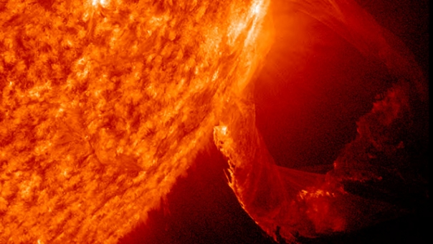

Present Threats to your Family
CYBER
SOLAR
- IMPROVISED NUCLEAR DEVICE
EARTHQUAKE
PHYSICAL ATTACK
FINANICAL
IEMI/RF: Intentional Electromagnetic Interference/Remote Frequency
PANDEMIC
EXTREME WEATHER: think Texas ERCOT!
Operator error
System malfunction
High Altitude Nuclear Burst (HEMP)
- Iran
- North Korea
- Russia
- China
Notes:
“Therefore, the skillful leader subdues the enemy’s troops without any fighting; he captures their cities without laying siege to them; he overthrows their kingdom without lengthy operations in the field.” -- Chapter 3, The Art of War, Sun Tzu
That’s right, they just unplug our power.
Again, I need you to remain focused on Beyond Designed-Base level events of which there are no plans or existing procedures to assist in your recovery, unlike lesser disasters. According to former FEMA Director Craig Fugate, “if the grid is significantly damaged, restoration could take months to years.”
Let me make one more point that is important when discussing threats, as from my viewpoint there is a marked differentiation between a Weapon of Mass Destruction (WMD) and a Weapon of Mass Effects (WME) with respect to the eventual extent of physical destruction and death, – as both are inexorably linked to Time. Simply speaking, in a WMD scenario such as a Nuclear surface/ground attack, most deaths will be instantaneous (e.g., Hiroshima/Nagasaki) in which people died directly from the attack or very shortly afterwards due to radiation. However, in a WME scenario such as a High-altitude Nuclear burst 40-400 kilometers in our atmosphere, a massive Solar Geomagnetic event, or a coordinated Cyber attack, will initially result in a minimal number of immediate and direct deaths. Still, over discrete periods of TIME, casualties will drastically increase (for reasons we’ll discuss later) due to “cascading effects” on other Critical Infrastructures that rely on assured electrical power to function.
As eloquently stated by Dr. Peter Vincent Pry, Director of the Task Force on Homeland and National Security, "EMP is a high tech means of killing millions of people the old-fashioned way, – through starvation, disease and societal collapse.“
My Bottom line: tremendously more lives will be lost due to a WME.

Slide 29
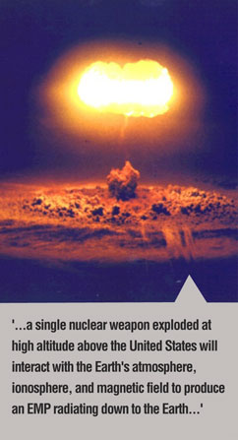
Iran
Russia
North Korea
China
Pakistan
NUCLEAR
Former Rep (R-AZ) Trent Franks: “We are only one act of madness away from a social cataclysm
unlike anything our country has ever known.”
Notes:
In my meager 12 years of being involved in the fight to protect electric grid it has become readily apparent to me that our federal and state elected officials, including emergency managers, have chosen not to “alarm” the American public concerning threats in which we have no defense or control over.
While on faculty at the Army War College I remember a visiting General Officer guest lecturer from NSA/Cyber Command who gave an unclassified lecture to students and guests on existing Cyber threats, followed by the usual Q&A, when the last question was asked “What keeps you awake at night?” Immediately the speaker excitedly proclaimed, “a HEMP, a high-altitude nuclear burst over the central part of Kansas, that will take out our entire electric grid, – and we’re screwed.” Think on this, - stated military doctrines of Russia, China, North Korea, and Iran describe an EMP attack in their wartime doctrine that I characterize as ‘prepatory fire.’ But be assured, any enemy will surely use additional means simultaneously including debilitating Cyber and Physical.
Another truth, - China has protected itself from EMP. Our Homeland has not.
The EMP Commission has warned "Although it is very difficult to predict exactly which electronic systems would be upset, damaged, or destroyed by an EMP attack, with certainty massive disruption and damage will be inflicted on unprotected electronics within the EMP field and, because of cascading failures, far beyond. EMP is analogous to carpet bombing or an artillery barrage that causes massive random damage that is specifically difficult to predict, but reliably catastrophic in its macro-effects."

Slide 30
Types of Nuclear Pulses
E1 – fast component of nuclear EMP, too fast for ordinary lightning protectors and destroys: ttransformers, generators, Industrial Control Systems, sensors, routers, radios, computers, communications equipment SCADA, antennas, circuit breakers. Strength of the E1 pulse is dependent upon the intensity of the gamma rays and altitude of the nuclear detonation.
E2 – many similarities to pulses produced by lightning. Least dangerous type of EMP because of the widespread use of lightning protection.
E3 – much slower longer duration pulse caused by the Earth’s magnetic field being pushed (distorted) out of the way in the Earth’s atmosphere by the Nuclear explosion or Solar Storm, followed by the field rapidly being restored to its natural place. Duration lasts tens of seconds to several minutes, producing Geomagnetically Induced Currents (GIC) in long electrical conductors like power lines, pipelines (even underground), railroad tracks, undersea cables, and will severely damage or destroy power line transformers with hundreds to thousands of amperes causing overheating and fires. This energy is multiplied by power lines, typically miles long, building up currents that can melt transformers.
Notes:
EMPs were known to be produced since the earliest days of nuclear weapons testing; however, the magnitude and significance of the EMP and its effects were not fully realized. A Nuclear high-altitude EMP will exhibit all three pulses, whereas a solar GMD/GIC will principally initiate propagate an E3 lingering pulse.
As Dr. Peter Vincent Pry has noted “A super nuke would inject 200,000 volts into the system in a nanosecond. But this can be protected against with a scaled-up surge arrestor. They have to be faster than lightning surge arrestors – which are too slow. The E1 pulse goes right through before it can be shut down. You need a faster and more robust surge arrestor that would deal with E1 and E3 effects.”

Slide 31
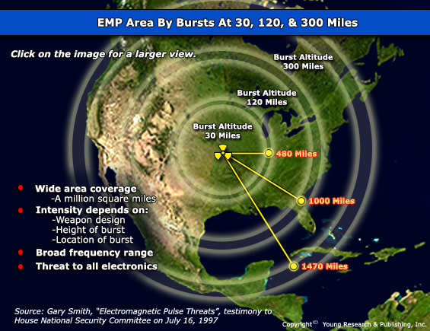
Notes:
This slide depicts the radius from a high-altitude nuclear burst at different heights, as an EMP has the capability of disrupting electric power generation, transmission, distribution and control systems, and further disable or destroy many elements of the remaining Critical Infrastructures supporting everyday life in America, Canada, and major portions of Mexico. Remember the statement from the Army General at the Army War College presentation mentioned earlier?
There will be horrific damage to critical SCADA control systems, commercial computers, circuit breakers, transformers, undersea cables (yes, even fiber-optic), generators, transmission power lines, data banks and so much more, – which will require critical repairs/replacements which will not be forthcoming, or even planned for at this time.
And the danger is not only in generation and distribution, as YOU and your need for electric power must be operating to create the LOAD that is critical to maintain balance of power.

Slide 32
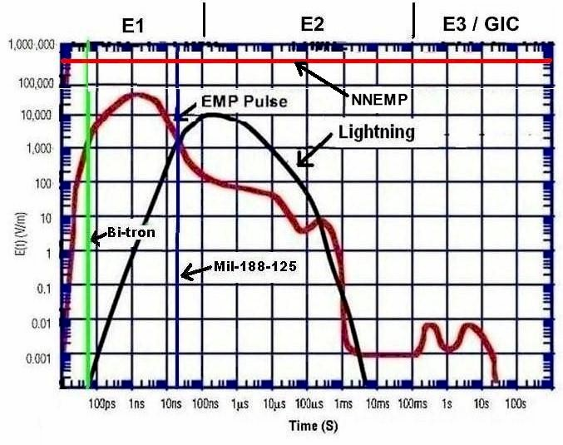
Electromagnetic Waveforms
Courtesy of Advanced Fusion Systems, LLC
Notes:
The most destructive portion of a High-Altitude Nuclear Burst (HEMP) occurs rapidly, as indicated on the Red line, from a Picosecond E1 pulse (1 Billionth of a second) to an E3 Ground Induced Current (GIC) pulse lasting longer.
Certain degradation/destruction of electrical equipment components and devices will be immediate. However, the most devastating toll will take place over time, as the other 15 Critical Infrastructures, after a relatively short period of time, will suffer from devastating “cascading effects” as they are distressed due to loss/destruction of ENERGY/Electricity. That, and that alone, will determine the timeline from disaster to catastrophe and consequently the number of deaths due to disease, starvation, and no rule of law which will encompass all urban, suburban, or rural communities. Certainly not a good time to live in a densely populated urban area.
The Blue line indicates a point after detonation/burst in which mitigation/protection takes place for military strategic level equipment from protections developed under Military Standard (MIL-STD) 188-125 to remain operational within the 50 kV per meter range. We civilian don’t have these protections but your military does. As far as the protected status for FEMA equipment and strategic communications don't know, but I hold little confidence that they do.
The Black line indicates "MIL-1898-125 EMP standard protection and military bases, it remains a guiding document for EMP protection.
The Green line Indicates the point where a device called Bi-tron, developed by Advanced Fusion System, has the capability to divert an E1 post to ground within 100 ps (a pico-second is one Trillionth of a second) which they have had it for years
My bottom line: Essentially, we have a Damocles Sword hanging over our Homeland. And not just Nuclear EMP.
NNEMP: Nonnuclear EMP, initiated by Intentional Electromagnetic Interference (EMI) or Remote Frequency (RF) has limited range but allows finer target discrimination sufficient for certain terrorist or military operations.

Slide 33
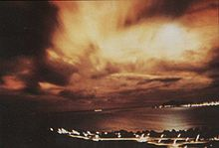
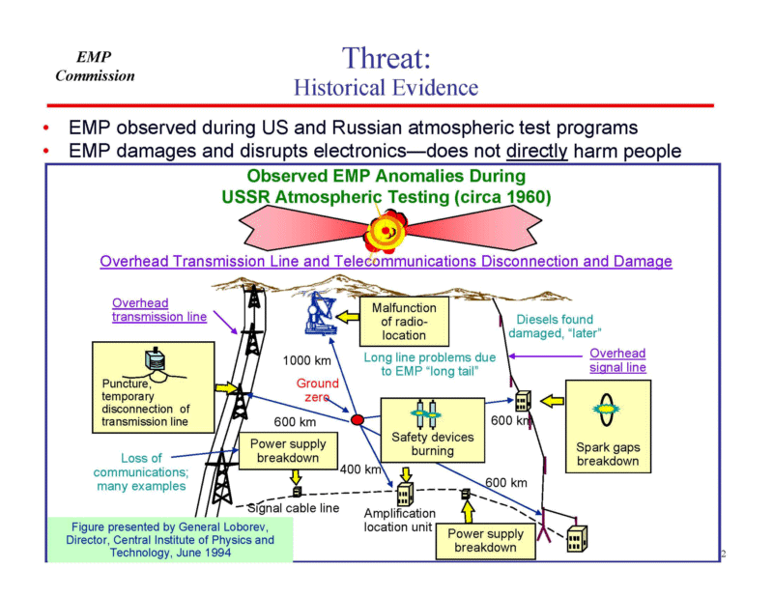
“The truth is, since 1963, after discovery of the EMP phenomenon during the 1962 STARFISH PRIME high-altitude nuclear test, every Democrat and Republican President and Congress have spent billions protecting U.S. strategic forces and command-control-communications from nuclear EMP attack. President Obama, on one project alone, spent nearly $1 billion to further harden NORAD’s Cheyenne Mountain command center against EMP. But U.S. electric grids and other life-sustaining critical infrastructures, that sustain 330 million Americans, have never been protected from EMP.” - Dr. Peter Vincent Pry
STARFISH PRIME seen from Hawaii Russian Detonation in 1962
Dr. Peter Vincent Pry, Newsmax 6 April 2021 article EMP Ignorance at The National Level
Notes:
Dr. Pry’s statement sums up quite well this entire presentation with the point that should be readily recognized at this time, - that if our military infrastructure can be protected/hardened, why can’t the civilian electric critical infrastructure segment be also? Your military has conducted numerous tests and have been hardening the systems against these threats for decades.
At a conference with U.S. and Russian scientists in 1994, Russian scientists shared information on the results of a Nuclear test over an industrial area in Kazakhstan, with a population of 148,000, as they wanted to determine the characteristics of EMP pulses on an actual target set to document how systems could survive. They didn’t, as it knocked out a buried 600-kilometer power line; fires were reported in the city's electrical power plant; diesel generators failed as did transmission lines.
We aren’t as barbaric as the Russians, as we have never tested equipment in an equivalent fashion in the United States over a populated area, - but we did detonate a 1.4 megaton fusion bomb 250 miles over the Johnson Atoll in the Pacific on July 9, 1962 called Starfish Prime, in which the flash was seen 900 miles away through heavy cloud cover from Honolulu. The blast triggered an Electromagnetic Pulse resulting in radios and telephones to stop working, and strings of streetlights on the island of Oahu failed. It also damaged, over months, six satellites that were rendered inoperable. Certainly not significant damage, but if we had an occurrence like that now, with our present level of sophisticated electronics is exponentially greater than in 1962, – we are devastatingly more susceptible and vulnerable a thousand times more.

Slide 34
Courtesy of Dr. Peter Vincent Pry
Notes:
North Korea (NOKO) lofted two satellites with the KMS 3-2 in 2012, and later the KMS 4 in 2016, both traveling at 400 km (the optimum level for detonation) that are orbiting over our Homeland right now on a regular basis. Worse yet, they approach our Homeland from the South where we have absolutely no Aegis land-based or sea missile intercept platforms, or any other means of detection or intercept. Iran has also successfully lofted a satellite in a similar trajectory.
This type of attack would be to their advantage as we’ll have little or no early warning before, and doubtful retaliation as we may not be able to confirm attribution in a timely manner as to who initiated the attack.
In their present state of existence, does NOKO really need an orbiting weather satellite over the U.S. and Canada?

Slide 35
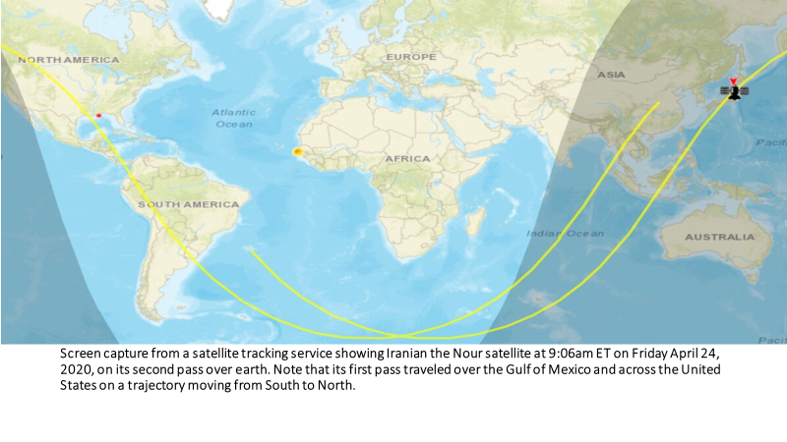
Notes:
This slide indicates the trajectory of Iran’s recent lofting of their Nour satellite. Do we know if any of these satellites have a nuclear capability to detonate in our atmosphere? No, not for sure, but in my judgement and zeal for protection, - always plan for "the worst-case situation." Then again, it's approaching from our southern coast, of which we have no defensive intercept capability anyway So don’t worry about it, right? Let’s just give them more money and lift sanctions. I may be just an old retired military guy, but when the enemy openly states they are going to kill you, - believe them.

Slide 36
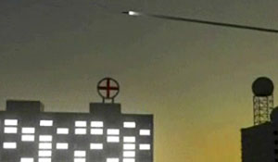
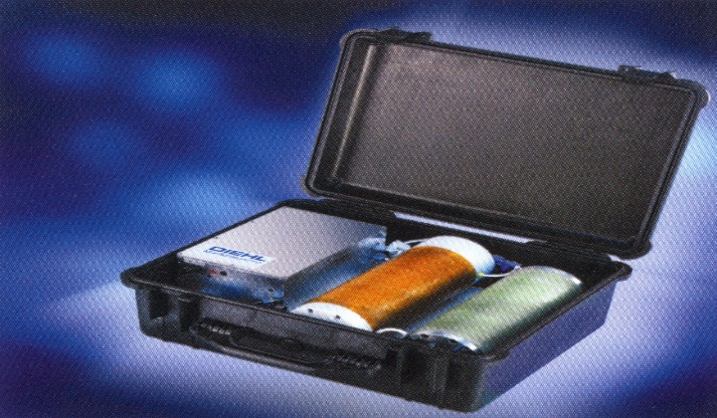
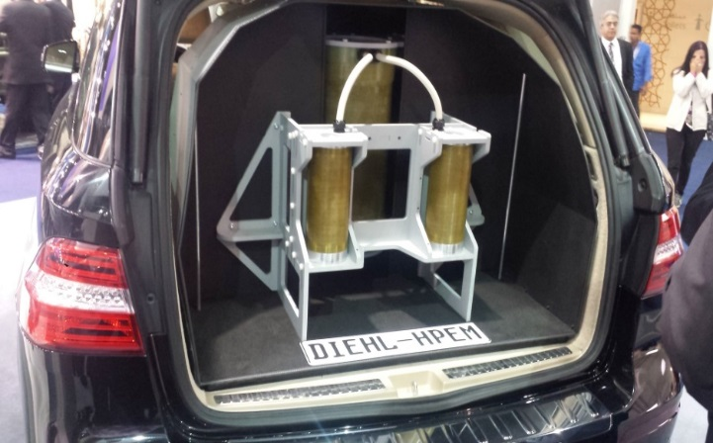
Additional Electromagnetic Spectrum
Non-Nuclear EMP (NNEMP) Platforms
Intentional Electromagnetic Interference “Suitcase” Weapon,
manufactured by Applied Physical Electronics, LLC
(100,000 V per meter)
Counter-electronics High-powered Advanced Missile Project (CHAMP) by Boeing
Intentional Electromagnetic Interference (IEMI) “Vehicle Mounted” Weapon
Notes:
Shown in the upper left is the CHAMP, Remotely Piloted Vehicle (Drone) that produces a Non-Nuclear EMP field to attack wide area targets. You can be well assured that potential enemy nations have a similar type delivery platform and, in the case of Russia and China, most likely have the capability to protect their equipment and Command and Control.
In the upper right portion is a vehicle mounted device that may look familiar, as it was portrayed in the movie “Ocean’s Eleven” to disable the Bellagio casino so it could be robbed. Present devices have greater refinement and extreme kilovolts.
The briefcase design is a relatively simple hand carried weapon that is available for purchase right now in the United States.
Except for the CHAMP, these are not overly sophisticated weapons platforms, and can be manufactured by any criminal element, or sleeper cells within the U.S. from Iran or other threat nations, or groups such al-Qaeda, Antifa or ISIS.
Dr. Bill Joyce, Chairman and CEO of Advanced Fusion Systems (which manufactures successful protective devices for our electric grid) stated, “I think when people understand how, and I hate to say easily, you can make one of these pulse devices, I’m afraid we’re going to find out that’s not an event with low probability; it’s an event with very high probability as it’s not too far down the path.”
Worse yet, there are arguably at least 51 missing nuclear weapons worldwide which could potentially fall into the wrong hands.

Slide 37
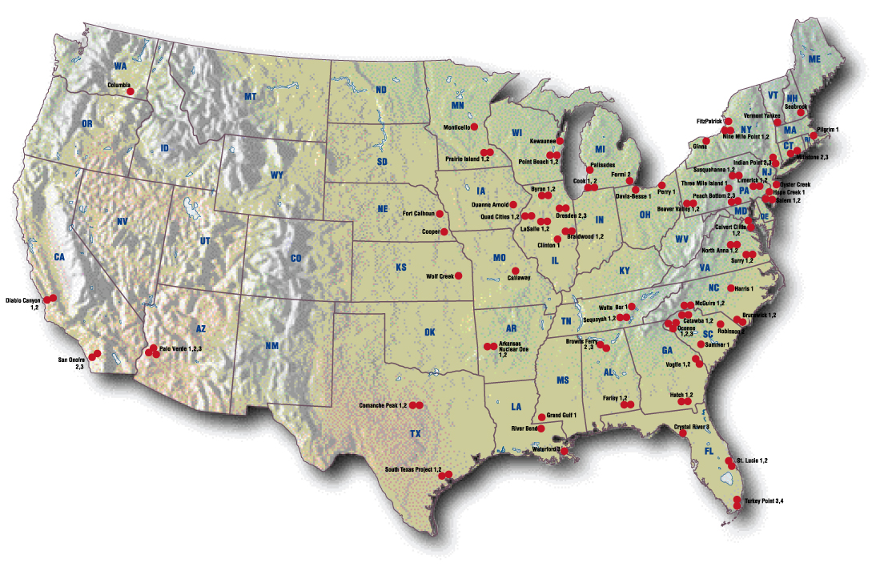
Notes:
Nuclear Power Plant (NPP) electric generation is one of the safest and cleanest source of electric power, but all NPP’s require the continuous outside power of a full-up electric grid. Therefore, many NPP’s are at risk for simultaneous melt down due a loss of continued and crucial outside power.
There are ~98 nuclear reactors operating in 30 US states.
There will be further second order effects of degradation and damage to NPP from a nuclear attack will affect switchyard transformers, Emergency Diesel Generators (EDG), SCADA control systems, motorized pumps, and communications. Further effects over TIME will include loss of essential workforce (may choose to be home with their families), inability to get to the plant, or the lack of specified cross training for workers remaining on station.

Slide 38
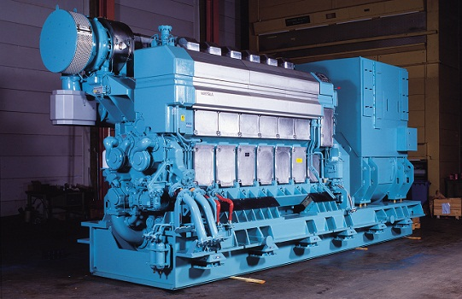
Emergency Diesel Generator (EDG)
Notes:
To assure power with the loss of outside grid power, Nuclear power plants have 2 or possibly 3 EDGs, most with a 95% reliability standard essential to keep the NPP continuity and cooling systems for the core and spent fuel pool constant. Initially battery power may last about 48 hours, followed by these EDG’s fueled by Diesel. The Nuclear Regulatory Commission (NRC) dictates that NPP’s must have ~7 days of supply of Diesel fuel on hand.
Therefore, the problem exists in that the NRC’s present plan states that the U.S. Army has been tasked to refuel NPP Diesel fuel storage tanks for assured operation.
The risks in planning for this support will be discussed shortly, with respect to at least Fuel availability and Personnel. But here’s a hint: refineries may not be operational!
With a true scenario such as this I think of the Fukushima fiasco, - as even now we fail to plan for the “worse case situation” caused by a “failure to imagine.”

Slide 39
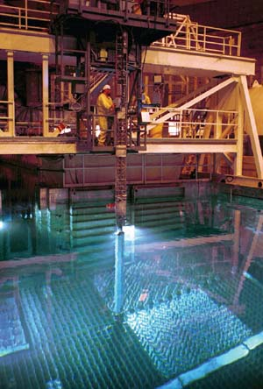
Notes:
The co-located Spent Fuel Pool (SFP) houses replaced core rods that remain hazardous, as radioactive material remains active for 3 to 5 years. Each rod has a Zirconium cladding/cover which, if exposed to air, becomes superheated and initiates an exothermic Zirconium fire. To ensure the safety of these rods, they must be submerged continuously in water.
It is hoped that backup EDG’s, after exhausting the power from the backup batteries, will maintain the stability of both the core and the SFP (along with Communication), - but refueling issues would possibly involve months of refueling which would prove nearly impossible due to non-functional refinery production and other factors we’ll discuss shortly.

Slide 40
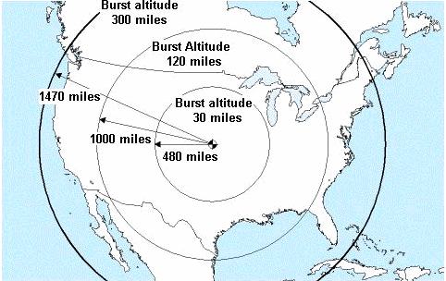
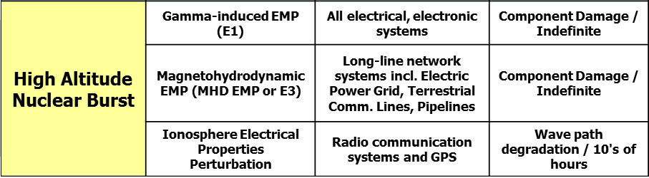
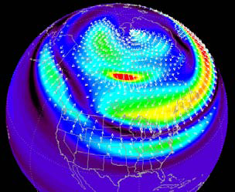
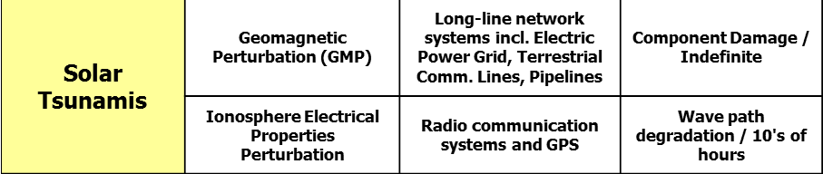
HEMP and Solar Summary Points
Courtesy of Dr. George Baker
Notes:
This excellent recap for both Nuclear and Solar was developed by Dr. George Baker, Professor Emeritus (James Madison University) and past Director of the Defense Threat Reduction Agency (DTRA).
The key operative word on this chart that should jump out to you is ‘Indefinite’. It is essential to install known physical protection, that is available right now, to deal with vulnerabilities on this chart that can protect the grid.
On 7 April 2015, NORTHCOM/NORAD Commander Admiral William Gortney stated NORAD is going back underground “because of the very nature of the way that Cheyenne Mountain’s built. It’s EMP-hardened.” He explained that North Korea now has mobile Intercontinental Ballistic Missiles armed with nuclear warheads that can strike the continental U.S. Well, so does China, Russia and soon (and most likely now) Iran!
An interesting fact of an EMP event is that we won't even feel it pass through our bodies, you won't even know it had occurred as it knocked out telecommunication systems, and significant portions if not all your electric grid. We would literally have no idea of the dread potentially waiting us, because there would be no communications, no mobility, and eventually nothing that our highly evolved, sophisticated, and electronic-based society relies on. That's the bad news. The good news is that we know right now how to protect against these threats as your military has been working on hardening its capabilities since the Cold War in the 1960’s (at least at the Strategic level only).
The bad news (again) is that our civilian infrastructure is about as soft as it gets, there is nobody in charge of coordinating a hardening of this infrastructure, and government response to date has been tepid and watered-down to the point that it is relatively meaningless.
My bottom line: never forget that your Military and FEMA is 99% dependent on the unprotected “civilian” electric grid.

Slide 41
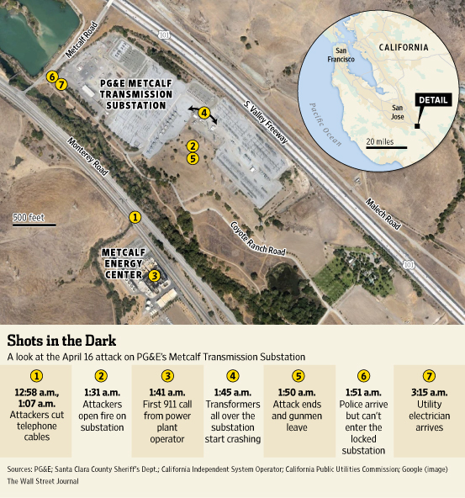
PHYSICAL ATTACK
Notes:
A well-coordinated and SEAL-type level of expertise small arms rifle attack occurred April 2013 at PG&E’s 500 kV substation in California as multiple individuals, positioned on the high ground outside the substation, targeted multiple EHV transformer oil cooling tanks with ~100 rifle (.30 caliber rounds) causing them to leak critical cooling oil, overheat, and become inoperative. Response time by law enforcement was 10 minutes, and certainly not that effective either. 17 transformers were damaged.
Following the attack, Metcalf spent ~$1M to protect this site. However, (and it’s laughable) one year later they were penetrated yet again resulting in some minor damage in the control house.
Presently, no substantive defensive posture exists for shielding these vulnerable substation nodes from attack, as the only existing protection for nearly all transformer substations is a chain-link metal fence.
As you're driving down the highway in your local community just look at noticeable substations in your local community area, where even a Boy Scout troop could penetrate with success (with limited to no law enforcement response).
What’s bothersome is that we presently have the technology to secure these installations. However, we have failed to do so on a mammoth scale.

Slide 42
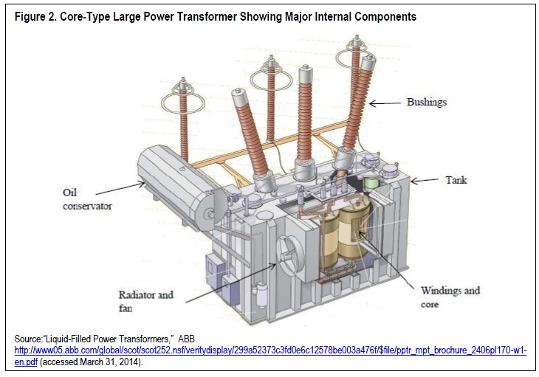
MAIN TARGET AREA
Notes:
The Metcalf attackers knew what they were doing as the oil conservator was specifically targeted. This was not workplace violence, - it was well planned and executed. Had attackers been successful in destroying most transformers, or a major portion of them, it would have severely affected Silicon Valley and the civilian community area for months. It should be noted that the rapidly developing field of do-it-yourself drones (Remotely Piloted Vehicles) suggests the growing possibility of strikes on transformers using explosive equipped autonomous aircraft.
As electric utility companies go, there exists a pathetic blindness with respect to potentially hostile factions conducting physical attacks on our grid. Ambassador (prior CIA Director) R. Jim Woolsey has eloquently stated that in order to protect any portion of the electric grid, you must figure out how you could create the biggest problem, then figure out how to defend against it, and then generate a whole sequence of thinking that is second nature to many planners within the military alone. He emphasized that as far as he can tell, that intellectual capability is almost completely absent in the electric power industry.

Slide 43
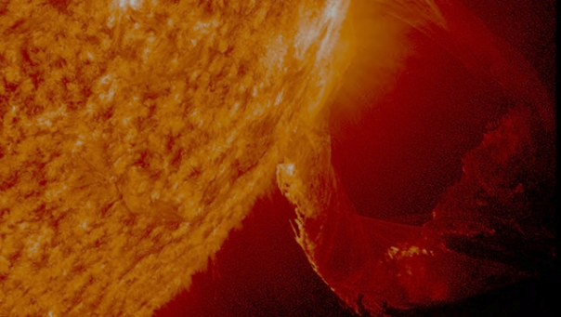
An inevitable event
Seriously damage, if not destroy outright, high-voltage transformers that are the backbone of the nation’s grid. It is impossible to replace these critical pieces of equipment if large numbers of them are taken down at once – ensuring that the power will be off for many months, and probably years in the affected areas.
SOLAR
Impacts Earth’s magnetic field at ground level with Direct Current.
Geomagnetic Induced Currents (GIC) flows into transformers and power lines causing saturation, overheating, false relay trips, harmonics, voltage loss, cascading damage and grid collapse.
Notes:
Earth experiences less intense Solar Storms regularly, but most of them are noted by minor effects on GPS, rerouting of flights in northern latitudes, satellite communications issues and of course beautiful Auroral displays. However, an extremely destructive storm can produce a Solar Coronal Mass Ejection (CME) produces plasma containing massive amounts of charged particles travelling extremely fast and projecting powerful radiation into space that can severely distort Earth’s magnetic field.
NOAA/NASA stated that there is a 12% probability of a major Solar Geomagnetic disturbance (GMD) per decade, - or could it be right now? Either way, you need to know that the electric industry has failed you by not providing any grid protection other than uncertain, untested and questionable operational procedures.
A large disturbance will have long-term, significant impacts on the nation’s electric grid given the interdependencies among Critical Infrastructure sectors, with rapid impacts on fuel refinement and distribution, transportation systems, food and water supplies, communications and equipment for emergency services, as well as other communication systems that are needed by utility technicians to repair electrical infrastructure.

Slide 44
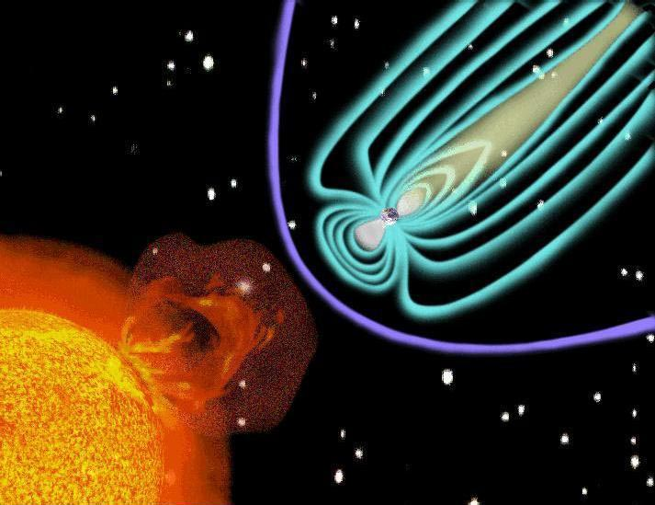
Solar Disturbance –E3 Pulse
U.S. Rep Yevette Clark, “The likelihood of a geomagnetic disturbance Event crippling our electric grid affecting the United States is 100%.”
Impacts Earth’s magnetic Field
Geomagnetic induced currents (GIC) flows into power lines and transformers
causing transformer saturation, overheating, false relay trips, harmonics increase, voltage drops, cascading damage, grid collapse…..
1859 Carrington Event
1989 Quebec electric grid
July 2012 Super storm
NOT IF, BUT WHEN”
Above: Graphic of a CME interacting with the earth’s magnetosphere
Notes:
Upon hitting Earth’s atmosphere this Coronal Mass Ejection (CME) produces a Ground Induced Current (GIC) drastically affecting transformers and generators, especially those within the latitudes of 55N-70N, but can also disrupt electric grids in mid-latitudes as well. Further flowing into the power grid at numerous points it introduces destructive currents on long transmission lines, undersea cables, pipelines, railroads, antenna’s and more. Our aged 40+ year transformers are extremely susceptible, as well as long-distance transmission lines.
Without a doubt the most devastating benchmark storm was the Carrington event of 1859 which destroyed telegraph wires and started fires globally (even in Australia) and some deaths. Sure, you might say not much damage done, but at that time all we had was the telegraph, and not the sophisticated and intricate microelectronic systems transformers, circuit breakers, satellites and much more that are thousands of times more susceptible to GIC than a simple telegraph line.
The 1989 Québec storm, a lesser level of intensity of the Carrington event, initiated a collapse lasting nine hours of America's Northeast electric grid and Canada leaving millions without power.
In July 2012 Earth narrowly dodged a solar superstorm similar in magnitude of the Carrington in 1869 by 9 days. Had we been hit we surely would not be having this discussion now. As our electric grid ages, and we become more and more dependent on electricity and increased demand, the risk of a catastrophic outage will become more severe.

Slide 45
Salem Nuclear Power Transformer Damaged During 1989 Geomagnetic Storm
Notes:
As an example, this is a “melted” 500 kV transformer winding as a result of the Quebec storm in 1989.
Not preparing for the 12% inevitable catastrophic solar event is like playing Russian roulette, as it’s not “if” but ‘when” the event will occur. Unbelievably, the electric industry still has no protective standards for a Carrington level storm.
We do have satellites monitoring the Sun’s activity that provide a 15-to-45-minute warning time of a geomagnetic storm, which could be sufficient for the electric industry to coordinate and execute protective actions by taking portions of the power grid off-line to protect transformers and other sensitive equipment before the event occurs. However, we lack command-and-control arrangements, or even a plan, to execute a coordinated nationwide shutdown of the grid by its ~3,000 utilities (or even a portion of them) nor have we ever practiced such a contingency for “turning the nation back on"--performing what is termed a “Black Start.“ Right now no one knows if a voluntary blackout of grid segments would avoid an EMP catastrophe.
During U.S. Senate testimony in 2016 a representative of the Edison Electric Institute was asked by Sen. Ron Johnson “Who makes the call" to shut down a portion of the electric grid in order to possibly safeguard the remaining half in such an extremely short amount of time? The representative from Edison Electric Institute (EEI) hemmed and hawed but eventually answered, "I do not know the answer to that question.“ As for so called experts like this to assume that operational procedures will be a cure-all is misplaced and deadly arrogant at its best. But remember, “when the comfortable encounter the unimaginable, the result is not only emotional, but also cognitive rejection.”
For pure entertainment it can be viewed at: https:www.hsgac.senate.gov/hearings/assessing-the-security-of-critical-infrastructure-threat-vulnerabilities-and-solutions.
My bottom line: we remain totally unprotected at the present time. Or better yet, where there are no expectations, there is no disappointment.

Slide 46

CYBER
Able to destroy an electric generator or transformer using nothing but a keyboard and a mouse.
Can initiate a chemical plant explosion, train derailment, Air Traffic Control downage, ‘ungraceful’ Nuclear Power Plant and fuel refinery shutdown to name a few….
Vulnerability increased as grid operators (and Hackers) can access remote operational field equipment (SCADA) via connections to the Internet.
North America’s electric Smart Grid operating systems are exposed to the public Internet, and therefore penetrable.
CYBER
Notes:
Existing war doctrines of China, Iran, North Korea and Russia specifically state in technical reports and military doctrine that they will initiate preemptive combined arms attacks using Cyber, High-altitude Nuclear burst, and ground Physical simultaneous attacks.
Grid vulnerability is significantly heightened as grid operators easily (but not securely) access the ubiquitous remote field Supervisory Controlled Data Acquisition (SCADA) systems and equipment via connections to the Internet (IoT) and directly to Operational Technology (OT) as nearly all North America’s electric grids operating systems are exposed to the public Internet at some point, and therefore penetrable. Introduction and expansion of the Smart Grid will substantially increase grid vulnerability.

Slide 47
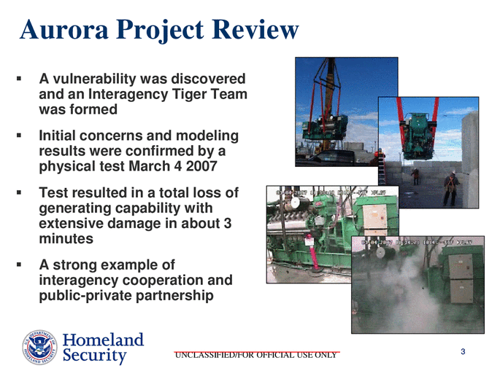
Notes:
The capability of Cyber to attack a critical component of the electric grid was shown in the 2007 Idaho National Laboratory sanctioned Aurora Generator Test in 2007 to demonstrate how a Cyberattack could initiate actual physical destruction of critical components of the electric grid. It simply used a computer program to rapidly open and close the circuit breakers of the initiating an ‘out of phase’ state from the rest of the grid, causing it to explode. You can see the actual destruction the actual destruction of the generator at https://www.youtube.com/watch?v=bAWU5aMyAAo
While this initial demonstration occurred in a controlled environment, it provided precise evidence of how future cyber-attacks will exploit vulnerabilities in critical infrastructure control equipment to trigger catastrophic physical damage to grid components, and especially to any moving or rotating machinery including pulleys, valves, pumps, generators and SCADA-enabled machinery, all of which are critical to the operation of networks that deliver power, water, oil and gas and so much more shown on the next slide.
My bottom line: Not speaking as an electrical engineer, I am convinced that Cyber can also be considered as Physical/Kinetic warfare (it causes physical motion and movement) in which our existing array of enemy forces from China, Russia, Iran and North Korea are presently quite proficient.

Slide 48
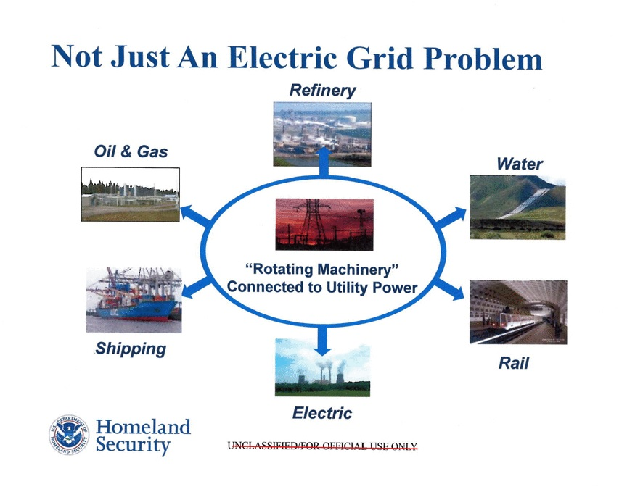
Notes:
Any function involving movement within the Operational Technology is vulnerable as shown. As Mr. Joe Weiss stated "It's the sensors, actuators, drives, etc. that need different approaches. These devices have no cyber security, authentication, or cyber logging. "
Our vulnerability has increased significantly since 2013 As we imported ~300 EHV transformers from Communist China, with one Chinese manufacturing company proudly announcing that their transformers support 10% of power to New York City, and 18% to Las Vegas! It’s suspected that China could impact our grid today with installed malware backdoors capable of extracting data to cause physical destruction at their choosing. In July 2020, the Department of Energy intercepted a multi million-dollar Chinese Extra High-voltage Transformer intended for a substation, when the DOE had it diverted to Sandia National Labs for investigation of internal backdoor malware. This occurred due to a previous back door intrusion discovered in a Chinese transformer installed at a U.S. utility. Since the seizure date a year ago, the government has not yet announced the results of forensic evaluation.
Hackers have long threatened American IT but are also now engaged physical processes of Operational Technology (OT). And Ransomware at the Colonial Pipeline fuel system, water systems in Florida and JBS beef provider plants to name a few can cause loss of view and control of physical processes.
According to Control Systems Cybersecurity expert Joe Weiss “There have already been almost 12 million control system cyber incidents that have caused more than $90 Billion in direct damage and killed more than 1,500. A targeted cyber attack against the US grid can shut it down for months.”

Slide 49
Defense Science Board Task Force
Report on Resilient Military Systems and Advanced Cyber Threat (January 2013)
The cyber threat is serious and insidious: the adversary is presently in our networks.
Current DoD actions, though numerous, are fragmented. DoD not prepared to defend against this threat.
U.S. networks are built on inherently insecure architectures, with foreign components
U.S. intelligence against peer threats is inadequate.
With present capabilities and technology, it is NOT possible to defend with confidence against most sophisticated attacks.
Notes:
Retired Army General Keith Alexander, former NSA/CYBERCOM Commander stated “The situation we have faced in recent years—with a fundamental lack of clear thinking about these problems—is particularly troubling because the reality is that adversaries will not wait for us to get this right. The U.S. cannot rely on a false sense of security; while our systems today are resilient and we are working harder to make them more so, we can and must do more now. The U.S. must stay ahead of the problem, think clearly about the challenges we face, and effectively make the critical decisions that are before us today—in a time of relative calm and before a major incident. If we fail to do so, we will have no one to blame but ourselves when that day arrives, as it inevitably will.” Note: Underline emphasis is mine.
The Annual Threat Assessment from the Office of the Director for National Intelligence in April 2021 stated that “Russia will remain a top cyber threat as it refines and employs its espionage, influence, and attack capabilities. Russia continues to target critical infrastructure, including underwater cables and industrial control systems, in the United States and in allied and partner countries, as compromising such infrastructure improves—and in some cases can demonstrate—its ability to damage infrastructure during a crisis.” But China has the same capability, - and additionally North Korea and Iran to a lesser degree. At this time, we have malware imbedded within our electric grid!
Yet another weakness exposing our electric grid innerworkings is that the Edison Electric Institute (EEI) which, according to their website, is the trade association representing all U.S. investor-owned electric companies. However, their member list includes three Chinese companies: China Southern Power Grid Company; State Grid Corporation of China and Power Assets Holdings. In other words, the government of Communist China—the very government that has been hacking the North American electric grid for years— is a member of Edison Electric Institute. These Chinese companies have an obligation under the 2017 Chinese National Intelligence Law to “support, assist and cooperate with state intelligence work.” Moreover, under China’s 2014 Counter-Espionage Law a company may not refuse the Chinese government when asked for information. So, this means that these members of the Edison Electric Institute have an obligation to provide information and assistance to the government of the People’s Republic of China. The same goes for the Electric Power Research Institute (EPRI) that advises the Department of Energy (DOE) on reliability and safety that not only has China as a member, but also Russia!
NSA: National Security Agency
CYBERCOM: Cyber Command

Slide 50
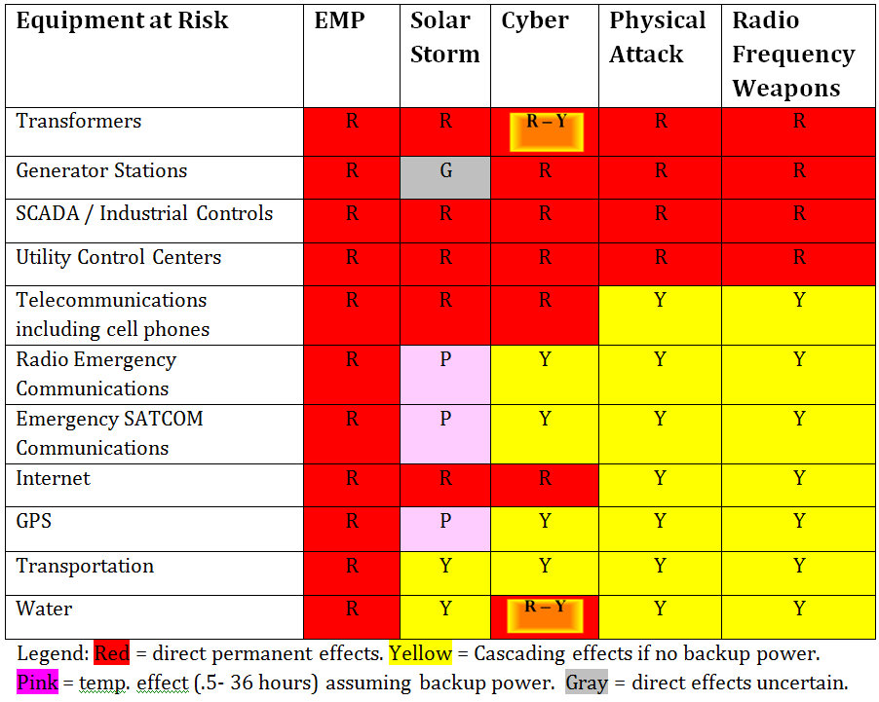
Cascading Critical Infrastructure Effects
Matrix created by Dr, George Baker, James Madison University 2012
Notes:
This is my favorite slide as it’s a very concise and visual graphic developed by Dr. George Baker on a few threats, as it says it all, – and it’s not encouraging.
Even the yellow segments are ominous and tenuous at best as it is inevitable, thinking worst-case situation, that an unknown degree of degradation will initially exist for at-risk equipment and more, as each sector of equipment will produce its own cascading effects downward will compromising our electric grid.

Slide 51
CENTER OF GRAVITY
The weakest and most vulnerable point of the enemy, that will ensure destruction
There can only be ONE COG and ours is ELECTRICITY
SINGLE POINTS OF FAILURE
FUEL: Degraded/Destroyed refinery production and delivery
COMMUNICATIONS: Degraded/Denied/Destroyed MILSATCOM, COMSATCOM, Internet, (NIMS and FirstNet highly questionable)
PERSONNEL: Availability of trained technicians, first responders, military, FEMA, farmers…..
TIME: Time is of the essence, ~3-4 weeks at most ‘Golden Time’ to establish a sense of hope, recovery
Vital Critical Risk Factor is FOOD Start thinking 332 million Urban, Suburban and Rural souls
Notes:
Now to the focal point of information where it reaches out to touch YOUR family!
When planning military offense operations, identifying and destroying an enemy’s Center of Gravity (COG) is the main objective, one that will cripple an enemy's capability to conduct operations or survive. For example, in World War II the COG identify the main target objective of warfare production and source of raw materials for Japan and Germany’s war effort.
I’ve also chosen four Single Points Of Failure (SPOF) that are needed to support the COG (much like a four-legged stool) as they are essential supporting components and functions of, in this case, - Energy/Electricity. Taken individually any of these SPOF’s would eventually cause the entire system to fail cataclysmically during a prolonged grid down outage, as each one is a significant “weak link” which poses a risk to the other three causing the whole system to stop working. In an ideal situation if a system component fails, another component should immediately take its place, – but that doesn’t play here at all. It’s essential to identify and protect these SPOF’s.
I also interjected the Critical Risk Factor of FOOD, which overall importance will be discussed later.
Hopefully you’re starting to grasp the magnitude of our vulnerabilities that past and present day elected officials of both parties at federal and state level, the electric grid industry and their lobbyists have allowed to worsen. And worse yet, they have failed to even inform you of the effects of losing life-sustaining electricity in this modern age.
It should be emphasized that the fundamental obligation of any government is to provide for the safety and well-being of its’ people. Now we’ll get into a realm of what’s being done, or rather more accurately what is not being accomplished, and what is the way ahead.

Slide 52
Notes:
You’ve seen this before, but I’m showing it once again to impress upon you the devastating effects of cascading failure, – think of it as the domino theory if you wish, – but the bottom line is that events occurring in one region of the country WILL rapidly affect other areas over an extremely short period of time for both our civilian population, and the “wished for” combined military response.
Perfect examples have occurred in recent history with the Northeast Black are 2003, Hurricane Katrina, the devastating loss of power in Puerto Rico, hurricane Sandy, and the prime example from the Texas ERCOT debacle which cost many lives.

Slide 53

SPOF: FUEL
Failure of Oil and Gas supplies due to pump and valve control destruction
Intricate operation, - must be selectively hardened and dedicated to crucial/critical points of need such as hospital centers, nuclear power plants, fuel transportation re-fueling points, generator resupply…..
None protected at the present time.
‘Preplanned’ assurances of raw oil supply to remaining functional refineries by supportive countries.
Notes:
Fuel and Transportation are both the lifeblood and circulatory system of our society. All fuels will become a substantial problem in a large-scale outage over a matter of weeks, but Diesel fuel is crucial for backup generators needed by military installations, utility industries, supply chain providers and Nuclear Power Plants MOGAS to a lesser degree.
Without electricity our ability to both refine and transport fuel products will be severely limited, as even large existing fuel storage tanks utilize electric pumps. Once on-site fuel storage stocks are depleted by any means, replenishment of Emergency Diesel Generators or on-site fuel tanks would prove impossible.
The lack of electric power will cripple fuel refinement and transport of gasoline and diesel. Regional fuel storage centers will not be able to move fuel tanker trucks to transport to retail gas stations, and retail gas stations cannot pump fuel. Petroleum pipelines require pumping stations to pressurize the contents to sustain flow, and are operational by the electric grid, or back-up diesel generation. SCADA control, monitoring and sensor viability may prove unreliable after a Grid Down event (even a short period of time) resulting in degradation or destruction of refinery operations and subsequent delivery.
It will be impossible in the short term to ‘harden’ ALL refineries and processing plants, - but any plans should prioritize and selectively harden selected refineries to receive shipments of raw products, continue refinery production and transport life-sustaining fuels to critical facilities such s NPP’s, hospitals, control centers, water treatment, FOOD production, ports, urban areas, etc…
My Bottom line: None are protected at the present time. Think Fukushima…. with no generator fuel for NPP SFP and core cooling for ~100 Nuclear facilities.

Slide 54
Fuels, Lubricants
Fuel Transport,
Shipping
Fuel for Generators, Lubricants
Power for
Signalling,
Switches
Transpor-
tation
Oil
Fuels, Lubricants
Power for Pumping Stations, Storage, Control Systems
Fuel
Transport, Shipping
Shipping
Power for Compressors, Storage, Control Systems
Power for Pump
and Lift Stations,
Control Systems
Water for Production, Cooling, Emissions Reduction
Electric
Power
Natural
Gas
SCADA, Communications
SCADA,
Communications
Water for
Cooling,
Emissions Reduction
Fuel for Generators
SCADA,
Communications
Heat
Water
SCADA,
Communications
Water for Cooling
Power for Switches
SCADA, Communications
Telecom
Shipping
Fuel for Generators
Emissions Reduction
Cooling,
Production,
Water for
Notes:
A perfect example of supportive and symbiotic interactions of Fuel and its effect on life-sustaining functions.

Slide 55
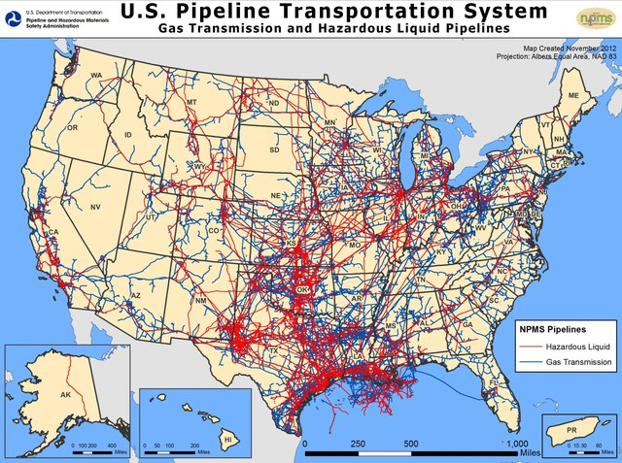
Notes:
It truly doesn’t take a military genius, or government worker at DHS, to figure out where our High-Value Target sets are, – it’s right there in Red in front of you.
The foolish and politically motivated edict to stop the delivery capability of the Canadian Keystone Pipeline further jeopardizes our survivability under catastrophic conditions, and only enhances our vulnerable COG among known enemy nations surrounding us such as China, Russia, Iran and North Korea.
My bottom line: refineries are essential, as are natural gas and oil pipelines. The electric grid is essentially our Homelands “nervous system,” refined fuel our “blood supply” and transportation as our “circulatory system” involving fuel trucks and pipelines. A perfect symbiotic relationship.

Slide 56
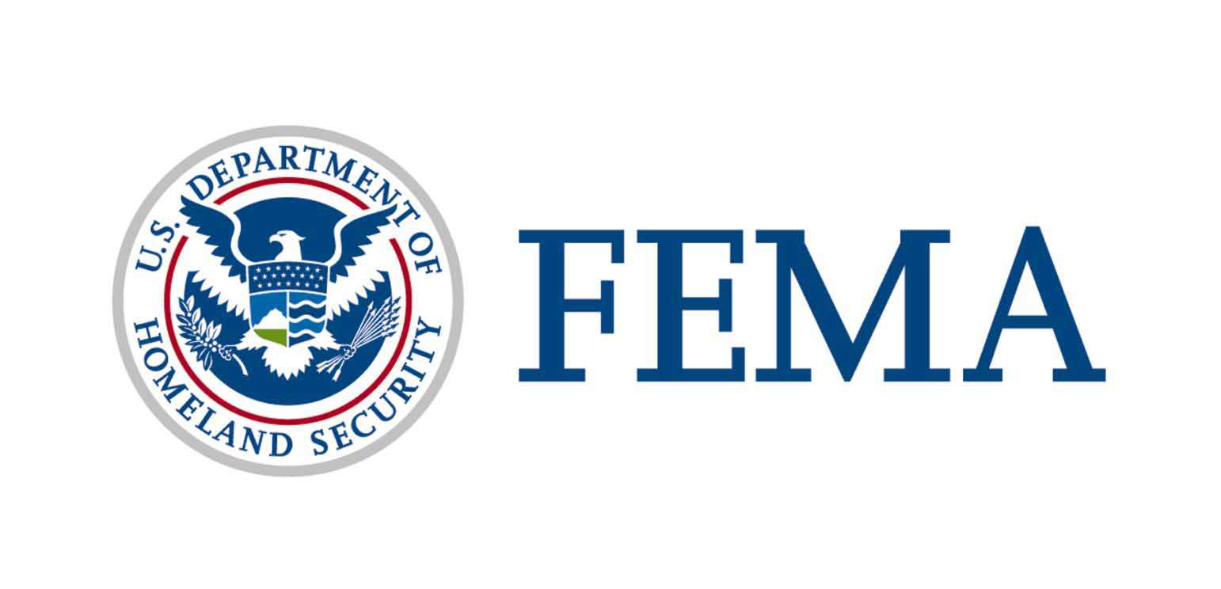
  SPOF: COMMUNICATIONS
Critical Communications During and After a Solar Superstorm Event
Chris Fugate
Notes:
The following four slides were taken directly from a brief by former FEMA director Chris Fugate (I have made no changes) in which he emphatically states that operational communications is critically important in response and recovery operations which will certainly, over a short period of time, result in Degraded/Denied/Destroyed military (MILSATCOM) and civilian (COMSATCOM) satellite communications. It's also important to know that all military services utilize an intense amount of bandwidth which they contract from civilian commercial satellites (COMSATCOM) to a greater degree than ever before,- which most likely are not hardened to the effects of either a Solar or Nuclear event.
Nuclear EMP would most likely affect significant numbers of microelectronics used throughout the communications industry, from satellites, antennas, and into non-hardened ground-based systems.
Solar E3 Ground Induced Currents (GIC) will directly damage electric power systems needed to operate cellular-phone service, 911 emergency communication centers and unprotected Data Centers. Most cell phone towers have battery backup, but optimally for ~4 hours or so.

Slide 57
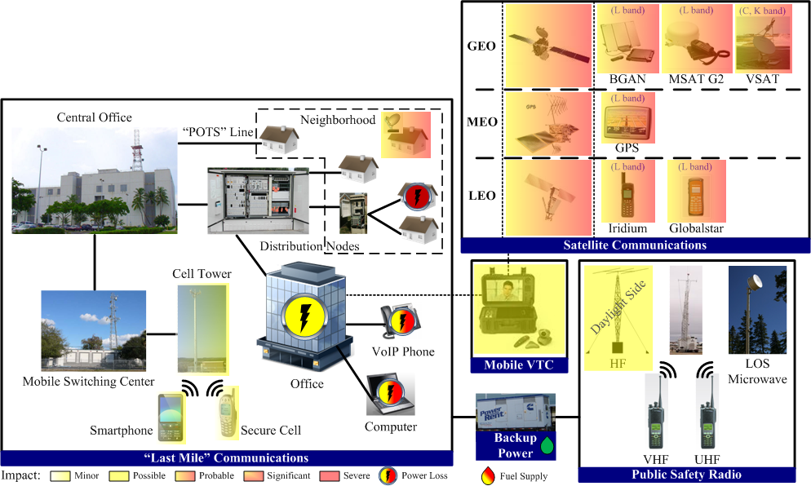
G5 Extreme Level Geomagnetic Storm
CME with southward magnetic orientation arrives at Earth causing extreme geomagnetic storm. SATCOM/GPS severely disrupted due to scintillation -HF may be possible
Notes:
As noted, a G5 level Solar storm will produce a Coronal Mass Ejection causing an extreme Geomagnetically Induced Current (GIC) especially long transmission lines many miles in length especially in modern high-voltage, low resistance lines, and are especially harmful to transformers (inducing core saturation) as well as tripping various safety devices and causing coils and cores to heat up to destruction as shown previously in the Salem nuclear power plant slide.
Cell phones themselves are likely to be undamaged by EMP, but not so with cell towers and ubiquitous 5G devices. Some commercial radio and TV stations may operate, but only with backup power.
Immediate degradation of military and civilian communication satellites is indicated in three orbits: LEO is Low Earth Orbit; MEO’s Middle Earth Orbit; and GEO is Geosynchronous orbit.
POTS: Plain Old Telephone System
VoIP: Voice over Internet Protocol
LOS: Line Of Sight
SATCOM: Satellite communications
GPS: Global Positioning system

Slide 58
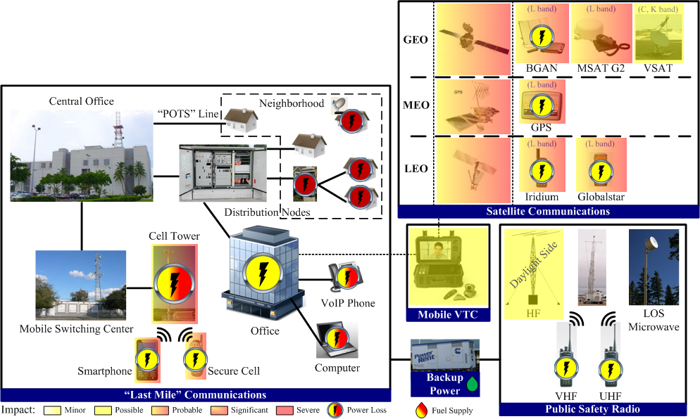
Loss of power begins to effect “last mile” Communications after G5-level Solar Event (GMD)
> 8 Hours
Numerous cellular towers begin to fail
Battery backup begins to fail
HF communications intermittent for next three days
Notes:
Greater than 8 hours, more systems start to show either total or partial damage resulting in greater deterioration.

Slide 59
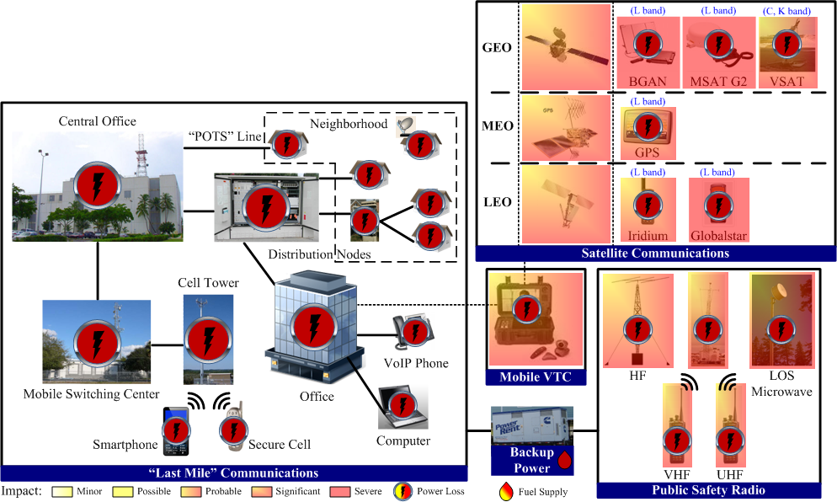
G5 Extreme GMD after 30 Days, and Beyond
Notes:
After ~30 days the only likely viable source of communications will be volunteer HAM radio operators which may remain operational only if they have fuel for the generators, batteries, and personnel/operators.
Line-of-sight public safety and commercial radio (HF, VHF, UHF, microwave) will work only if power can be supplied to systems and receivers.
HF radio can provide communications over extended distances in the absence of other means, also if power is available.
Emergency 911 dispatchers are Mission Critical Partners, but back-up generator fuel supply is typically ~ 3 days of fuel supply at best. Unfortunately, like everyone else they must rely on contract fuel deliveries which “thinking worst-case situation” will not be operational due to loss of refinery production transportation fuel after a few days.
So, think on this: If you have a house fire, and your Fire Company is miraculously dispatched by your 911 center, they may have little fuel to get there. Even if they do arrive, most likely they’ll be no water pressure, and compromised microprocessors that enable fire engine pumping systems and ladder trucks to function, and worse yet probably very few Firefighters.
My bottom line: communication status will not improve from this point on, unless we do something to prevent it from occurring in the first place! That’s why you’re here now looking over these Death by PowerPoint slides.

Slide 60
FEMA Recovery brief from past FEMA Director Craig Fugate
Custom extra-high voltage (EHV) transformers for the electric power grid take 12-24 months to produce.
Total replacement will take years.
Estimates for national economic recovery are between 4 and 10 years.
Notes:
Again, these statements are from an authoritative source, – not mine.
What should concern you now is that if this situation was so well-known, why haven’t conditions changed with subsequent FEMA Directors? It may not be totally mystifying, as DHS and FEMA are completely engulfed with reacting to emergency Design Based-Events, and have chosen to avoid (under the direction of DHS) even basic development of proactive policies, plans, procedures or exercises for known Beyond Designed Base Events which DHS has ignored?
Again, it’s important to remember that we presently have the technological means to protect/harden significant portions of our electric grid to possibly alleviate reaching the catastrophic-cataclysmic level resulting from cascading effects among all 16 Critical Infrastructures.
Bottom Line: communications must operate early in a crisis to provide situational awareness and enable responders in efforts to restore additional critical infrastructures. And to keep the public updated for their situational awareness.
It is essential to keep the public informed on the conditions surrounding them during this crucial time, as rumors and untruths will increase tension when people perceive themselves as being totally helpless, leading to violence at a rapid pace, especially exacerbated if there is no rule of law present.
Now is the time to ask yourself, and ask your elected officials directly why, while your military is protected (at least at the strategic level) is your family and your community completely on their own to recover and survive?

Slide 61
SPOF: PEOPLE
The assumption that functions will continue as before the crisis began is called NORMALCY BIAS, as it’s one of the biggest reasons why most emergency plans will fail in spectacular fashion in a Grid Down event.
Emergency planners at all levels presently lack imagination and understanding of existential threats in which just the thought of total societal collapse is so disconcerting, unbelievable, and hard to plan for, – that for decades they just ignore it, pretend it doesn’t exist, or put it in the ‘too hard’ column.
Planners must not assume that personnel critical to recovery such as Fire, Police, EMS, electric grid workers, military, medical, refinery personnel, NPP technicians and more will be on hand due to anxiety and concern for security of their family members.
Inform and encourage personnel to maintain family provisions for several weeks minimum.
Plan for shelter, provisions, security of responding personnel AND their families at military installations, fire, police, EMS, hospitals - as personnel will surely “walk” as the time span of the event lengthens.
Always plan for the worst-case scenario.
Notes:
Think about one more negative: what will be on the mind of military and FEMA personnel that initially report or remain on duty during and after a catastrophic event, no matter if they’re Active Duty, Reserve or National Guard (Homeland or overseas) after a prolonged time period with no contact from their families and loved ones, - what will weigh heavily on their minds? What will be their ‘readiness level’ with that undeniable and mind-numbing uncertainty that is apparent with thoughts and concerns of their loved ones in this time of “never imagined” desperation and chaos? Will they be truly thinking of the mission and you first?
I have met many senior military and emergency response leaders who wrongfully assume (and I know what the word assume means) personnel will remain on duty for the long haul. Wrong.
So, ask yourself at what point will responding/recovery personal continue to man installations and support strangers, especially when local logistical support to their installation of FOOD , fuel, electricity, water/sewage, medicine, and civilian workers to name a few?
The same goes for Defense Industrial Base (DIB) personnel supporting all military forces (manned by civilian workers). Will critical DIB functions continue without a workforce or supporting supply chain critical supplies? No, they will not. They’ll be with their families for support and security where they belong.

Slide 62




So, are trained personnel necessary? Will they be available?
Notes:
To show you the importance of having available trained workers and technicians available to proceed with any hope of recovery necessary following a massive Grid Down event, this slide shows you the complexity of just moving 1one replacement Extra High-Voltage transformer with transportation alone.
By the way, optimistically speaking, there will be numerous EHV Transformers needed to be replaced/repaired. Imagine now, as this is just transportation and installation, the staggering number of essential workers that are essential to support the other critical infrastructures return to operation!

Slide 63
Military and FEMA Operational Level
The American people will ultimately look to the U.S. military for survival.
Military forces in the Defense Industrial Base (DIB) are 99% dependent on the same commercial electric grid as are you, and ALL Americans.
Both FEMA and Military are not prepared to conduct operations, nor assist in response/recovery/reconstitution operations in a truly catastrophic-cataclysmic level event, - called by FEMA a “Maximum-of-Maxims” or the Military term “Complex Catastrophe”
The military is proficient at planning for lesser level disasters but is not prepared for worst-case catastrophic situations. A totally innovative shift in development of policy, plans, scenarios and exercises is crucially needed.
There are no plans on the shelf right now by either NORTHCOM or
FEMA to aid American citizens over TIME.
Notes:
Planning for a prolonged and catastrophic loss of electric power is not disaster planning as usual, such as KATRINA and SANDY, or wildfires in California, catastrophic planning requires “outside the box’ level of thinking which we no longer have, - a totally innovative shift in planning. We are severely lacking in this type of leadership and thinking, and have been for decades.
My bottom line: while we may have adequate personnel for response, we will certainly not have sufficient personnel or resources to sustain recovery of great magnitude over TIME.

Slide 64

SPOF: TIME
Optimistically, a “Golden window” of OPTIMALLY 3 weeks may exist to maintain the public’s sense of recovery is dependent upon SPOF’s degradation of additional Critical Infrastructures.
Notes:
John Kappenman, an expert on the effects of EMP and solar weather events on the electric grid, stated "the industry is badly miscalculating the risk that are posed by these disturbances or attack scenarios. That's a serious problem... perhaps the largest natural disaster scenario that could occur to modern-day society." When he was asked about either natural or man-made catastrophe, and with what functional pieces may be left, and how quickly can you stitch them back together to some functional level he replied, "I care about the availability to bring the system back rapidly in a few days at most - if we can't do that, we see the potential for innocent lives being lost perhaps within the matter of just a few weeks, more than all of the wars this country has fought in its history."
This is where the term “The Golden Hour" comes to mind, from a military and first responder perspective, as a term for getting a patient to definitive medical care ASAP is appropriate here also. But in a Grid Down event, we will experience possibly a Golden ~3-weeks to a month or greater recovery time span which will determine how long the public will endure, depending upon the eventual deterioration of supporting Critical Infrastructures. How long will our Golden Hour truly last during the early stages of a catastrophic/cataclysmic level event? What will day 1 look like, or day 3, 7, 30, or 90 onwards? The easy answer is not very long, as selected critical systems must recover soonest to enhance the chance of maintaining a sense of recovery within the public. Even rolling blackouts could help secure water, communications, fuel for food delivery to begin with.… and may provide time to lessen the inevitable societal unrest and chaos that will follow. In the case of total blackout TIME is the difference between a sense of recovery, or the breakdown of societal order. After a TIME of no law enforcement or leadership at even the rudimentary level, restoring order may be irretrievable.
Whatever happened to the idea of “readiness” in the emergency planning realm taking into account the inevitability of cascading failures?
How can you be prepared or be ready for a threat you’ve never researched, and you don’t understand?

Slide 65
DYNAMICS IMPACTING LOSS OF A NATION
REVOLVES AROUND TIME
HUMAN DESPERATION: A feeling of complete hopelessness and a life out of one’s control. It’s a negative psychological response to suddenly living in a horrific social chaos that is completely unrecognizable to a person’s previous way of life and will likely result in uncontrollable and utter despair.
STARVATION: This does not include just food deprivation, but true starvation on a scale that has never been experienced in this nation. After a short time, civilian and military alike could go possibly weeks or more without a single substantial meal. The psychological effects on the U.S. population is drastically ignored in all emergency planning as outside help always arrived.
LIVING WITOUT RULE-OF-LAW (WROL): Living in an environment where there is no rule of law other than self-regulation, will quickly lead to horrible atrocities not seen since the 12th century. Witnessing these events will be traumatic to most individuals.
From Jon Hollerman,
“GRID DOWN: Death of a Nation.” Former USAF SERE instructor.
Notes:
The fact is that our nation has never been prepared materially, or psychologically, to survive a long-term and prolonged electric power blackout lasting beyond a few weeks. Think and plan “outside the box” and always for the “worst case” situation level.
What would be the availability of any outside assistance coming to your state, your town, your village, or home to help during a prolonged cataclysmic-catastrophic event if several to all 10 FEMA regions are involved simultaneously and not able to assist?
HOW WILL YOU PROVIDE FOR YOUR FAMILY WITH INEVITABLE EXTREME DISEASE, STARVATION, and NO RULE OF LAW?
My bottom line: time is not on our side!

Slide 66
You, Some Local EMP Consequences
1. Failure of critical infrastructure: lack of essential goods and services; Medical, potable water, Sewage, FOOD…
2. Insufficient/non-existent responders: Military (National Guard, Reserve, Regular); DHS, FEMA, DOE ….
3. Lack of intelligence gathering, situational awareness: FBI, DHS, State fusion centers, Law Enforcement, NORTHCOM…
4. Impaired ability of local governance: disorganized, limited control, local ad-hoc law…
5. Personnel: Fire, Police, EMS, nursing homes, hospitals…
6. Hazardous material (HAZMAT): Nuclear Power Plants; Chemical and Biological storage facility security…
7. Flight or stranded: transient population movement; Colleges; nursing homes; hospitals, prisons (Guards)…
8. Collapse of mutual aid agreements: no assistance, as resources needed locally…
9. Breakdown of civil order: looting, gang violence, riots, civil disobedience…
10. Hoarding: rush to amass excess goods, Food, medicines, fuel, weapons/ammo…
11. Degraded External Communications: radio, TV: hard to get correct information (if any at all); rampant rumors…
12. Back-up generators: lack of fuel/lubricants, repair parts…
13. Urban Population center meltdown: significantly shorter time frame to chaos; no infrastructure services; sanitation, water pressure, Fire, EMS, Police…TOTAL THREAT TO THE RULE-OF-LAW
And let’s not forget the production, processing and delivery of… FOOD
Notes:
This slides lists a few consequences to provide you just a glimpse of how life will change over TIME.

Slide 67
Most emergency response planners erroneously use their previous experience dealing with natural disasters like hurricanes and tornadoes as a launching point for their emergency response to approaching any plans for a grid down scenario. In a grid down scenario don’t plan on having entire federal agencies, the military/National Guard, numerous volunteers, metric tons of civilian food or water donations, functioning interstate trucking system, unlimited federal funds and the full support and ingenuity of the American people to assist. Plans now have zero basis for performing the same tasks in a world without electricity!
Authors and experts of emergency planning cannot truly envision the operating environment in which they are making their emergency plans.
Some aspects of a grid down event are debatable like what electronics will still work, will my car start and will it run.
What is not debatable is that it is fundamentally impossible to feed 332 million Americans spread out over 3.8 million miles without farming, electricity, interstate trucking...
It cannot happen. You will not even be able to feed a single major metropolitan city for one day without electricity.
From Jon Hollerman,
“GRID DOWN: Death of a Nation.” Former USAF SERE instructor.
Notes:
The Food and Agriculture Sector is almost entirely under private ownership and is composed of an estimated 2.1 million farms, 935,000 restaurants, and more than 200,000 registered food manufacturing, processing, and storage facilities. This sector accounts for roughly one-fifth of the nation's economic activity. It has critical dependencies with many sectors, but particularly with:
Water and Wastewater Systems, for clean irrigation and processed water
Transportation Systems, for movement of products and livestock
Energy, to power the equipment needed for agriculture production and food processing
Chemical, for fertilizers and pesticides used in the production of crops
I intentionally did not include FOOD as a Single Point of Failure, even though it would quickly manifest itself as one.
To gain a useful appreciation of this type of environment, I strongly recommend you read an excellent book by Jonathan Hollerman entitled “Survival Theory: A Preparedness Guide” in which he recommends preparing for a longer period than the DHS/FEMA mantra of a few days to a couple of weeks, - but rather a significantly longer-term food storage. Just to give you a hint, it’s not just stocking up canned food and flour and other items for whatever span of time you’re considering, he also discusses the importance of thinking ahead and plan for planting crops for the worst-case situation.
The bottom line is very simple, food producers need a food supply support system in place with railways, processing plants, trucks, fuel, a financial system, and WORKERS.

Slide 68
In 2008 the Congressional EMP Commission resolved that nearly 90% of our population will not survive the first year following a High-Altitude EMP detonation which will damage hard to replace equipment, initiating cascading effects on all Critical Infrastructures.
EXAGGERATED?
UNREALISTIC?
Possibly, but even the most skeptical would cringe if we lost only:
1%? 3.3 million
5%? 16.6 million
20%? 66.4 million
As a comparison, the Covid-19 death rate is as of 12 Aug 2021 is
635,219 deaths amounting to 0.0019%
Notes:
Current U.S. Population ~332 million
The 2008 EMP Congressionally commission stated, after eight years of study, that the result of cascading failures from High-Altitude Nuclear burst will result in 90% of the population in the U.S. dying within the first year due to the loss of life-sustaining electricity and non-functioning Critical Infrastructure.
That number turns off most people when I mention that huge percentage of deaths which, by the way, was objectively determined by eminent nuclear physicists and electric engineers of the EMP commission, and not refuted even in their latest 2017 report.
So, go ahead and think of it in smaller percentages and see how those numbers appeal to you as your fellow citizens go without electricity for many months. Now try to imagine ‘life’ in New York City, Philadelphia, Pittsburgh, San Francisco, Detroit, Baltimore trying to maintain some semblance of society without electric power for even a month!
Compare that to the recent Covid – 19 death rate, and the devastating effects of turning our Homeland upside down with numerous ancillary problems as suicides, depression, bankruptcies, severe loss of business and many other factors.

Slide 69
So, this is the way it’ll go down :
As discussed in SPOF’s over a short TIME local First Responders will experience shortages of critical fuel, communications, food, medicine, drinking water, wastewater sanitation, and personnel-- and they will then,
contact their State Emergency Management office and Governor to ask DHS/FEMA for help;
in which the Governor will then call the President for help;
in which the President will call the Secretary of Defense and say, “send me everything you’ve got.”
Notes:
Since this will be a ”come as you are event” it most likely will affect all military forces within the continental United States forces (CONUS) and the withdrawal of all military forces overseas (OCONUS) ASAP.
The Area of Operations (AO) these responding forces will enter will be unprecedented and hard to imagine. But with what I know, I’ll walk you through portraying a “picturing time” of what it will be like initially for these responding forces.

Slide 70
Department of Defense (DoD)
Disaster Emergency Support Function to DHS/FEMA
Planning support, subsistence, administrative supply, petroleum products, engineering and construction supply, water and mobile units, medical material, telecommunications management, and transportation management.
Provide bottled and bulk drinking water, construction materials, and engineering service.
Provide a robust capability of mobile field elements and logistics support teams.
Provide commodities distribution assistance and expertise to include, points of distribution training and state-level project management support for commodities missions.
Support the hauling, installing, operations and maintenance of DHS/FEMA generators for critical public facilities and provides generator lease and purchase support.
Chemical, Biological, Radiological, Nuclear Enhanced (CBRNE) and Hazardous Material (HAZMAT)
CAN YOUR MILITARY PERFORM THESE MISSIONS FOR A PROLONGED PERIOD OF TIME, - FOR SEVERAL MONTHS OR longer?
Notes:
The DoD is tasked to provide military capabilities and functions tasks through NORTHCOM to assist DHS along with State/Territory National Guard. However, viable response and recovery is dependent on TIME, which is highly doubtful. I believe that NORTHCOM may have the capability to assist for possibly a few weeks, after which they themselves will have difficulty performing mission, or even maintain self-sufficiency due to degradation and assured loss of their supporting Defense Industrial Base, in addition to the Single Points Of Failure discussed previously. Remember, your military is 99% dependent upon the same commercial electric grid which your family is!
This is where it’s essential to ensure DHS does its’ job, as it was ordered to in past federal legislation, that emphasized the importance of educating First Responders (Fire, Law Enforcement, EMS), Military (NORTHCOM and National Guard), civilians, and electric utility companies of Beyond Design-Based events. The 2020 NDAA specifically orders DHS to develop a National-level EMP Exercises, as FEMA has stated that they plan to conduct the national level exercise in 2021. We’ll see if that happens. If conducted, it must not ignore the certain Single Points Of Failure that will affect recovery.
NORTHCOM was established in 2003 with the sole mission to protect the Homeland and is supported by forces from all military Services upon activation with some Active-Duty of all branches, Reserves. Also, individual state National Guard forces, trained to operate within a Chemical, Biological, Radiological and Nuclear Enhanced (CBRNE) environments, have plans and training for such missions. In a catastrophic-to-cataclysmic event, that may involve several to all 10 FEMA regions simultaneously, these assigned CBRNE forces will not be sufficient and will be overwhelmed, requiring additional totally untrained General-Purpose Forces (GPF) such as Infantry, Artillery, Engineers who have not experienced any training whatsoever for conducting operations in an Area of Operations they’ll be called upon to engage in a truly cataclysmic environment where they’ll certainly be quickly overwhelmed.

Slide 71
UNTOLD REALITIES
(elected officials and the electric industry don’t talk about, or want people to know)
FEMA and DoD are not prepared to conduct operations nor assist in response and recovery ops, in a Complex Catastrophe (or true catastrophic-cataclysmic event) encompassing Urban, Suburban and Rural Areas of Operations involving several or more of the 10 FEMA regions simultaneously will be unprecedented and hard to imagine as
No plans, scenarios or exercises exist at this level.
All military services, critical Defense Industrial Base, and their supply-chain providers are also dependent on the same civilian electric grid as you are.
DoD military at the Strategic level (e.g., Cheyenne Mtn, Air Force One, strategic communication sites) are prepared/hardened, but not most Operational (FEMA) and especially not Tactical/unit level Active, Reserve or National Guard.
The Area of Operations (AO) that NORTHCOM, National Guard and FEMA personnel will enter and attempt to maneuver within will be unprecedented, brutal, inhumane and hard to imagine, --
but with what I know for sure, I’ll walk you through it……..
Notes:
As stated before, our FEMA, military and First Responders (Fire, Police, EMS) perform admirably during local and regional disasters as in most cases THEY WERE TRAINED TO DO SO with “on the shelf” plans, procedures and exercises. However, with catastrophic degradation/destruction of electric power affecting other 15 critical infrastructures, would require activating several to all 10 FEMA regions simultaneously to respond to a massive Grid Down event as it progresses well beyond weeks.
Such a catastrophic-to-cataclysmic level event will be in an unchartered scenario, – a “come as you are” exigency that has never been exercised. Compounding the problem further is that the Defense Industrial Base and its’ critical supply chain providers, will severely affect the sustainability of any responding military forces.
But this is not disaster planning as usual for any military forces, state OEM’s, FEMA, utility companies, and local responders or other federal entities as it requires a truly “whole-of-government” approach and effort.
The Area of Operations (AO) in which responding NORTHCOM, local National Guard and FEMA personnel will engage and attempt to maneuver within will be unprecedented, brutal and inhumane to imagine, - But with what I know for sure, I’ll walk you through it……..

Slide 72
FEMA and NORTHCOM General-Purpose forces (GPF) are not trained for operations in a truly cataclysmic Volatile, Uncertain, Complex and Ambiguous (VUCA) environment as:
Responders are not operationally or psychologically prepared for what to anticipate when
immersed in intense operations as there are Zero existing plans or exercises to conduct operations, or even survive themselves, in an extreme VUCA environment at the catastrophic to cataclysmic level.
Neither does local level Fire, Law Enforcement or EMS, as no substantive plans, scenarios or exercises for such a worst-case situation has ever been developed to assist commanders, officials at all levels, and ESPECIALLY Troops and Responders for operations in the Homeland---
- involving several if not all FEMA regions simultaneously,
- responsible for operations in vast Urban, Suburban, and Rural areas simultaneously,
- over multiple jurisdictions,
- for a prolonged period of time,
while trying to maneuver within an intense humanitarian disaster environment,
Notes:
All responding personnel will be entering into an extremely Volatile, Uncertain, Complex and Ambiguous (VUCA) environment in which they have not been prepared to deal with operationally, materially, nor psychologically.
I can state with certainty that our superb Service members will be completely overwhelmed.
The bottom line is that their fate is now in the hands of their Commanders who are responsible for be informing/training in peacetime to deal with this type of cataclysmic environment which soldiers undoubtedly have not imagined or experienced what starvation and desperation is. They must be prepared psychologically to operate in "unimaginable" areas of operations themselves but, even more importantly, to prepare and sustain their families while on duty.

Slide 73
- with overwhelming needs for mass care, shelter, graves registration, sanitation,
law enforcement, potable water, FOOD, and medical assistance demands,
- ALL while threatened by severe civil conflict, desperation and societal unrest,
- plus severely degraded/denied/destroyed communications capability among military/FEMA/local efforts,
- resulting in degraded to no Situational Awareness, or GPS for essential PNT,
- with loss of Air Traffic Control capability after short period of time, affecting any Joint Reception, Staging, Onward Movement and Integration,
with highways and roadways congested - blocked,
with patrolled by well-armed marauders/groups,
with limited to no unit self-supporting provisions for power generation, transport, medical, refueling, water and FOOD resupply,
all within the likelihood of a severely uncontrolled Chemical, Radiological, and Biologically, and Nuclear enhanced contaminated HAZMAT environment (Nuclear Power Plants).
Notes:
It's important to clarify that operational methods will vary in Urban, Suburban and Rural areas as each will have their own unique operational environment never planned for or experienced. Stressing conditions at the catastrophic and above level, Urban populations will not have the resources to survive beyond possibly 1 week as life will be logistically unsustainable for food, water, sewage, fuel, medicine, heat/AC, Fire (water pressure), EMS, Police (Rule of Law) and more you can think of. Sending unprepared military or FEMA personal into such area of operations will not turn out well.
The most significant bottom line yet: the only way for an Urban/Metropolitan area to survive a prolonged long term power outage, is to maintain sustained electric power flowing into it, which can be curtailed to lesser percentages of power to support essential functions.
But then again, these are factors that are consistently bypassed, overlooked or dismissed for another time by unimaginative and inconsequential exercises that have been held as ALL comms, water, food, fuel, rule of law and more miraculously returns to the status-quo. This is failure to Imagine at it’s best.
GPS: Global Positioning System
PNT: Position, Navigation and Targeting is a critical enabler of military systems needed in electronically or physically challenging environments.

Slide 74
WHAT IS REQUIRED OF DoD AND DHS (FEMA) NOW:
“Train as you fight,” it always works. Initiate large-scale catastrophic plans, scenarios and exercises that will train Active, National Guard and Reserve forces for effective interaction with FEMA, and ALL levels of responders. Mentally prepare forces to provide support to civil authorities in ways they have never done so previously in a catastrophic VUCA environment. POTUS Exec Order 26 March, and NDAA
Plan for loss of communications, both MILSATCOM and COMSATCOM, in all exercises. Develop mitigation plans and exercises to operate through denied, degraded or destroyed space comms using manual workarounds (messengers) and proficiency using High Frequency Line of Sight comms (HAM radio). Train responders now to operate in a degraded/denied comms environment, even when better/more reliable space comms are available.
Military and DHS leaders must work to develop and instill confidence and promote resiliency for personnel and their families to deal materially and psychologically within the “the new normal” for possibly a very long time, -- and not expect assistance.
Raise awareness of troops and their families of the personal choices they will have to make between their FAMILIES and loved ones, versus the assigned mission, during a prolonged period of time and uncertainty.
Fatal Error of Military and Civilian planners today is taking PERSONNEL availability for granted
Notes:
Train as you fight” always works! Train military conventional GPF and 1st Responders on alternate HF comms and include them in all catastrophic scenarios and exercises. This type of training is not implemented now by any of the Services, nor FEMA.
Initiate development of large-scale plans, scenarios and exercises for Title 10 and 32 forces to interact with FEMA and prepare forces to provide support to civil authorities as never done so previously. Train responding forces to network with FEMA’s NIMS (National Incident Management System) radio protocols at the lowest level.
Compel responders to operate under degraded conditions in exercises even when better/more reliable space comms are available. Intentionally upset their assured comms comfort level. The problem is that nearly all prior exercises at the disaster level “assumes" that communications, fuel, personnel will remain available and that many critical infrastructures will remain viable. This will prove to be a huge and deadly assumption.
NORTHCOM, DHS/FEMA must drill and exercise to document issues and vulnerabilities with public utilities and private sector partners, in order to develop and encourage resiliency for personnel and their families, and the overall civilian populace to survive “the new normal” for a prolonged and unknown timeframe.

Slide 75
The fundamental obligation of government is to provide for the safety and well-being of its’ people.
Little to no substantive Cyber, HEMP, IEMI, GMD, Physical protection in place by DHS, congress, past administrations, or especially the electric industry to ensure electric power grids for civilian and military-based, leaving our Homeland vulnerable to catastrophic consequences.
Our local emergency responders are presently straining to keep up with the everyday demand for their services and have no existing surge capability to handle extremely large-scale events.
First responder community (e.g., National Fire Academy, EMS, Police) planning nothing: no EMP directives or plans.
DHS/FEMA /DoD/NRC/DOE and your State government have NO existing policy, plans, scenarios, or exercises for simultaneous multi-regional catastrophes for BEYOND DESIGN-BASED EVENTS from man-made or natural threats.
Excellent plans exist for DESIGN-BASED disaster contingencies as KATRINA and SANDY, wildfires, tornadoes, earthquakes….but In my research none factoring in truly existential Cascading effects.
We must ensure that our EMS/PHS, LEO, Fire have adequate resources, and are informed so that qualified PEOPLE are prepared materially and psychologically to assist while they can.
American communities remain dangerously unprepared to respond with no mitigation plans for BEYOND DESIGNED-BASED long-term, multi-FEMA region catastrophic grid down events.
Notes:
The fundamental obligation of government is to provide for the safety and well-being of its’ people. Some minor ‘movement in the force’ has occurred within Executive Order from the past administration, and Congressional legislative efforts which ordered federal agencies (DHS, DoD, DOE) to initiate implementation of grid protection, - and that’s good news. However, the truth is that many time-marked deliverables have been stonewalled at federal agency levels by kicking the can down the road with more studies and research.
As an active firefighter and a member of an ambulance company, and I can assure you that at our level we have received zero guidance or training from DHS/FEMA, or our state Office of Emergency Management, to prepare for any recovery at the catastrophic level. And as far as SPOF personnel goes, we’re already in bad shape as are many other First Responders across the nation as in my state of PA we have a critical shortage of volunteer Firefighters. In 1989 had ~300K firefighters, – and personally a little under 40K. So, right up front many American communities remain dangerously unprepared to respond to acts of long-term multi-FEMA region catastrophic grid down event. Federal Agencies, Commissioners of the Federal Electric Reliability Commission (FERC) and the NERC, have done absolutely nothing to protect the lives of your family, or theirs.
My bottom line: is another quote from CSM Michael Mabee and that “all roads lead to Civil Defense.” But even a robust CD plan will prove effective for only a specific period of time, which is discussed very insightfully within Jonathan Hollerman’s article “Grid Down: Death of a Nation." If you haven't read John's article is yet, now would be a good time.

Slide 76
POLITICS AND THE FAILURE TO IMAGINE, or more accurately
FEDERAL INACTION TO DATE
2010 – GRID (Grid Reliability and Infrastructure Defense) Act – failed.
2013 – SHIELD (Secure High-Voltage Infrastructure for Electricity from Legal Damage act)– failed.
2013 – Critical Infrastructure Protection Act (CIPA) – failed.
2014 – GRID Act resurrected – subsequently failed.
2015 - Critical Infrastructure Protection Act (CIPA) – failed .
2017 – National Defense Authorization Act (CIPA act included) – unknown federal agency actions.
2019 - POTUS Executive Order: federal agencies protect the electric grid – no substantive action.
2019 - National Defense Authorization Act - unknown federal agency action.
2020 - National Defense Authorization Act - unknown federal agency action.
OVERALL:
8 Laws proposed related to Power Grid threats: 2000-2016
3 EMP Commission reports: 2004/2008/2017
45 Fed Agencies & Commission reports: 1983-2018
18 Executive Orders & POTUS Documents: 1996-2020
71 separate Congressional hearings & Reports from 1997-2018
46 documented Congressional records on EMP threats: 2005-2017
BOTTOM LINE: Absolutely no life-sustaining electric grid equipment has been hardened!
See https://michaelmabee.info/category/mikes-blog for in-depth and accurate intrigues on why the grid isn’t protected over the past two decades.
Notes:
The Department of Homeland Security stated that protection of critical infrastructure supposedly has been high priority, - but in truth it isn't. President Trump’s 2019 Executive Order 13865 promoted realistic national EMP protection at the highest level of national policy, and included elements of earlier failed CIPA legislation of 2013 and 201 by Congress inclusion within the fiscal year 2020 National Defense Authorization Act passed (NDAA) which supposedly gives it the force of law and some “teeth’. But not so, as it then hit the proverbial brick wall of federal agencies where it was stonewalled for various reasons.
Even now absolutely nothing has changed, as CSM (Ret) Michael Mabee stated in his Secure the Grid Now blog (michaelmabee.info) “The bottom line is that the electric utility industry is spending tens of millions of dollars per year influencing Congress is why grid security legislation has been so difficult to get passed. The true irony is that this money ultimately comes from our electric bills.” Over the past 10 years electric company lobbyist money of $1.2 Billion went to elected officials, in addition to campaign contributions of $149.5 Million . “Electric customers are unknowingly funding a campaign against grid security!” He further stated that “The Federal Government’s regulators, departments and agencies have had decades to demonstrate this leadership and take effective action to protect critical infrastructures from all hazards and they have failed.”
There have been military and government personnel who have tried to warn Congress and the American people of this great threat that have had their careers cut short, as even the Congressional EMP commissions work was sabotage for years by the powerful forces arrayed against them such as the electric utility industry and its lobby and its allies in government.
That nothing has been done harden/protect your electric grid, millions of dollars had been spent on lobbying and political influence, - with much of it geared towards downplaying threats, insulating the electric industry from oversight, and prioritizing profits over public interest, safety and security. A great example is the recent Texas Winter storm grid down fiasco that led to many deaths.
As Michael Mabee stated we are engaged in a “David and Goliath People v. Electric Grid Utilities” fight, exacerbated by a few highly positioned and politically entrenched federal employees who have failed congressional orders to protect the grid. This is where you are desperately needed, to contact elected officials to closely monitor and ensure they fulfill their responsibilities as ordered. Their inaction will determine your very survival.
Dr. William R Graham, chairman of the Congressional EMP commission, stated "we are very close to having five career DHS and DOE bureaucrats deciding for 330 million Americans that the U.S. should not be protected against the real EMP threat. Frighteningly reminiscent of the bureaucratic politics that left New Orleans unprepared for a category 5 hurricane Katrina, because such was considered highly unlikely or impossible.”
I no longer have faith in any legislative body to protect your family and mine in a timely manner, as not 1 electric utility entity has actually implemented hardening technologies within either Bulk or Distribution systems.
But let not your heart be troubled, as there are numerous individuals and organizations (cited on slide 92) who are fighting on your behalf, but unfortunately are relying on their grocery budget to raise awareness of these existing lethal dangers that your government ultimately doesn’t want you to know about.
For fascinating information on the political intrigues as to why the grid isn’t hardened/protected, and accurately “follow the money” of electric grid lobbyists to your House and Senate elected officials, I encourage you to visit CSM Mabee’s Civil Defense Blog at https://michaelmabee.info/category/mikes-blog

Slide 77
2017, 2019, 2020 National Defense Authorization Acts
Develop and report strategies to protect and prepare critical infrastructure threats from EMP and GMD. ACTION : Unknown
Conduct research and development to mitigate the consequences of EMP and GMD. ACTION : Unknown
Identify critical utilities, national security assets and infrastructure that are at risk from threats of EMP and GMD. ACTION: Unknown
Conduct an evaluation of emergency planning and response technologies that would address the findings and recommendations of experts, including those of the Congressional EMP commission, which shall include a review of the feasibility of rapid isolation one or more portions of the electric grid from the main electrical grid. ACTION : Unknown
Conduct an analysis of available technology options that are available to improve the resiliency of critical infrastructure to threats from EMP and GMD, and an analysis of neutral current blocking devices that may protect high-voltage transmission lines. ACTION : Unknown
Assess the restoration and recovery capabilities of critical infrastructure under differing levels of damage and disruption from various threats of EMP and GMD. ACTION: Unknown
Develop a new National Planning Scenarios focused on protecting and recovering the nation from an EMP catastrophe to prevent societal mass destruction thru collapse and starvation. Status unknown.
Conduct outreach to educate owners and operators of critical infrastructure, emergency planners, and emergency response providers at all levels of government regarding threat of EMP and GMD. ACTION: Unknown
Requires DHS NLT June 2020 to develop plans and procedures to coordinate response to and recovery from the effects of EMP and GMD on critical infrastructure. Status unknown, or not announced
Requires DHS to start pilot programs demonstrating that the national electric grid can be protected from the catastrophic consequences of an EMP event cost-effectively. A previously established USAF "pilot study" is ongoing in San Antonio.
Notes:
Here’s just a few examples from 2017, 2019 and 2020 NDAA’s (three of them) that should matter to you. What's difficult to comprehend is that from the published and distributed 2008 Congressional EMP Commission Report, to finally have Congress take action with 2017 National Defense Authorization Act only took 9 years! Totally unbelievable!
Each NDAA displays the ‘perception’ that the federal government is serious towards the catastrophic level impacts of a long-term national scale electric power outage. But truthfully, the weakest links are the Federal Agencies tasked for completion. To me, as a first responder, it means that millions of emergency planners and first responders across the nation including police, firefighters and National Guardsmen, have not been told and therefore not aware of threats capable of disruption or destruction of our electric structure. I'm not holding my breath on this, as all 3 NDAA that passed and signed by the President have not been fully complied with by any federal agencies.
An example to watch for is in the 2020 NDAA, which tasks DHS to conduct a National Level exercise by 21 December 2020 to test preparedness for an EMP or GMD event. Well, that didn’t happen. But FEMA now states it plans to conduct the exercise in 2021 (but don't hold your breath on that).
My experience in many exercises, and strategic-level one’s at the Army War College and National Defense University/Johns Hopkins Applied Physics Laboratory is that while at least some movement, they are consistently flawed as they “assume” assured communications, fuel and food availability, transportation, law enforcement and EMS support and people will not be degraded.
Additionally, most exercises scenario run at most a 3–5-day time span and disregarded any major cascading effects that would most certainly trigger premature closure. However, the exercise would cease anyway as it would eventually reach a culmination point where they approach the “too hard” column, and it ceases. This is where the real work should begin and conduct what is called a "deep dive" to study how to deal with and correct any deficiency. But right now I hold no faith that any DHS/FEMA exercise will result in sound “out of the box” ideas, as it will likely end up as yet another milque-toast CYA endeavor.
If electric utility lobbyists and campaign contributions hadn't influenced CIPA passage in 2013/15, and federal agencies didn’t ignore the NDAA “rule of law and orders” starting in 2017, we may have been further along on securing our electric grid than now.
As an active Firefighter/Rescue, and Ambulance Company VP, if DHS actually complied with the NDAA to "Conduct outreach to educate owners and operators of critical infrastructure, emergency planners, and emergency response providers at all levels of government regarding threat of EMP and GMD” we would be further ahead. None of my fellow First Responders are aware of any outreach effort from DHS or the National Fire Protection Association of any threat to start plans and procedures to deal with a prolonged electric power outage. It also stated the importance of raising public awareness, and apparently that's not happening at all..

Slide 78
It Doesn’t Have To Be This Way
PILOT TESTS and OTHER INITIATIVES
San Antonio - Joint Base San Antonio (SA-JBSA) Electromagnetic Defense has experts from federal, military, industry, state, academia working to ensure the 11 military bases, and the surrounding San Antonio area, maintain sufficient electric power supply after an EMP, Physical or Cyber attack. The findings will produce a cookie-cutter model to be used across both military and civilian installations and areas. CPS Natural Energy, the nation’s largest municipally owned energy utility, is a key supporter.
Lake Wylie Pilot Study of York County, South Carolina focus on determining costs for EMP protection and brings together Duke Energy, the South Carolina National Guard and citizens. Based on thorough analysis, estimates are the cost is about $100 per citizen to secure the areas grid against EMP.
Idaho National Laboratories is strengthening the ability to guard against EMP events by testing and validating technology has been developed to protect HV and EHV transformers from both GMD’s and EMP’s. I believe they’re examining the EMP hardening transformer Neutral Blocking Device designed to provide automatic protection when GMD or EMP induced currents in a transformer are detected.
Side Note: this technology exists now, it works, we know the names of the manufacturers right now, - why further study and analysis?
Sandia National Laboratories in2020 is undertaking a $40 million multiyear campaign “focused on defending large electric utility systems from potential attacks by hostile nations, as well as from damage inflicted by extreme natural disasters like hurricanes and solar flares.” The work is important to ensure that multiple generators are not disabled simultaneously.
Notes:
A true success story is the San Antonio Pilot initiative spawned from two “first-of-its-kind” U.S. Air Force Electromagnetic Defense Task Force (EDTF) workshops under direction of Lt Gen Steven Kwast (Ret-USAF), who recognized that an attack on our aged and vulnerable electric grid, our true Center Of Gravity, would severely degrade and deny military operations, the Defense Industrial Base supply chain, and most assuredly all aspects of commerce to the civilian electric power system. Yes, a real-life visionary and heroic Maj Gen Billy Mitchell in our lifetime!
The Pilot Project has surged forward with cooperation of the City of San Antonio, 11 surrounding military installations, CPS Natural Gas and the University of Texas-San Antonio along with 90+ other organizations. I must highlight that CPS Natural Gas Energy Company of San Antonio is an exception when I talk of power companies, as they have been 100% behind the effort to harden and protect the city of San Antonio area and its 11 JBSA military bases and for continuity and, - to save lives. The problem of TIME remains a factor as, best case, it may take a minimum of 2 years to finish the pilot test, with an undetermined amount of time until it's reasonable to export this schema to other military installations and civilian sectors.
Lake Wylie Pilot study has been in existence over five years and surprisingly has not received any government assistance by DOE. Experts have successfully determined two important questions, one of which is the estimated cost protection, and whether the protection efforts would be viable. It has generously received a $1 million EHV of energy to be tested in a national lab, is been lacking even transport money to bring it to the lab from the Department of Energy. This great project is totally supported by Ambassador Hank Cooper, who founded the High Frontier insightful website, and is a subject matter expert on the “wide-open gap” now existing along our Southern coastline with respect to enemy ICBM or Satellite attack vectors orbiting our Homeland. Efforts of South Carolina’s collaborative grass roots effort with Duke energy and the South Carolina National Guard, will prove to be a great model for computing a bottom-up assessment protection program, and cost analysis.
Ambassador Cooper stated it best as he said that he has lost faith that Washington will ever act to protect the national electric grid and other life-sustaining critical infrastructures from EMP and cyber warfare. And that if America is to be protected, it won’t be done by an incompetent federal government but by the people and the states working “from the bottom up.” I like the way he thinks and agree totally, – that's why I have so much hope in this rather critical, but long presentation. Here's where I usually add my pithy comment that “a Jackass is a thoroughbred racehorse horse designed by a government committee.
Bottom Line: Essentially, we are the voices that must be heard, from the true bottom up!

Slide 79

Notes:
A microgrid generally operates while connected to the grid, but more importantly it can disconnect and operate on its own using local energy generation in times of power outages. A microgrid can be powered by distributed generators, batteries, and/or renewable resources such as solar panels or wind turbines.
You should be aware by now that all military and civilian infrastructure is totally dependent on our overwhelmingly vulnerable and unprepared civilian power grid. In 2015 the Defense Threat Reduction Agency (DTRA) declared that an EMP from small nuclear devices detonated in the upper atmosphere, or attacks by high-powered microwave devices driven in panel vans, could render civilian power grids inoperable with possible restoration taking weeks, months, or “may not be possible.”
DTRA essentially called for development of modularity and islanding at DoD sites to ensure survivability, and may also be applied to the commercial sector and other areas of the government: hospitals, civilian infrastructure, businesses, etc. DTRA called for practical EMP-protected microgrids as a solution to the problem. And yes, the problem is the current electric grid!
When completely isolated from the larger grid, EMP hardened microgrids with their smaller transmission line footprint, makes them immune to Nuclear E3 and GMD effects.

Slide 80

MODULARITY:
The Rangely Initiative:
A Grassroots Solution
Educational Outreach
Public-Private Partnerships (PPP)
Innovative Technologies
Community Commitments
Notes:
“The people of Rangely, Colo., are not waiting for Washington to protect them from a Great American Blackout caused by a solar superstorm or cyber warfare or electromagnetic pulse (EMP) attack. Like several other Western municipalities, Rangely, a town of 2,300 in northwest Colorado, home to a community college, has rolled up its sleeves and, in the best traditions of Western pioneering spirit, independence and self-sufficiency, is building redundant microgrids so they can survive anything (Dr. Peter Vincent Pry, Executive Director of the Task Force on National and Homeland Security).
According to Don Davidson, also from the Task Force on National and Homeland Security "small towns in America are the solution to not only the resiliency of America’s power grid, but in the creation of independent power systems free from threats like the Texas winter that killed hundreds of people or other cyber, terroristic, or natural threats. Systems are available right here in Colorado."
This is a fine example Americans of not waiting for big government secure their lives, - but taking responsibility upon themselves where it ultimately is.

Slide 81




NuScale SMR
Typical Pressurized-Water Reactor
Containment & Reactor System
NuScale Power Module
Combined Containment Vessel and Integral Reactor System
76' x 15' cylindrical containment vessel module containing reactor and steam generator
Notes:
Another tremendous initiative is NuScale’s Small Modular Reactor (SMR) as a great source of power in modular and island mode.
Dimensions: 76' x 15' cylindrical containment vessel module containing reactor and steam generator
Weight: ~ 700 tons as shipped from fabrication shop
Transportability: Barge, truck or train
Uses natural convection for cooling: inherently safe, gravity-driven natural circulation of water over the fuel. No pumps, no need for emergency generators.
It requires no outside power source and can operate safely.
Provides >30 days cooling followed by an unlimited period of air cooling.
Seismically robust as reactor pool attenuates ground motion and dissipates energy.
Reactor is 1/20th the size of large reactors
Defense-in-Depth
Multiple additional barriers to protect against the release of radiation to the environment.
High-strength stainless steel containment.
Reactor core has only 5% of the fuel of a large reactor.
Produces 10-Megawatt electric capacity.
This is an ideal invention that will certainly save lives.

Slide 82
A Glimpse of Some EMP Consequences that will Affect You
- Failure of critical infrastructures: loss of essential goods and services, Medical, potable water, sewage, ATM, banking, FOOD…
- Insufficient to non-existent responders: Military (National Guard, Reserve, Regular); DHS, FEMA, DOE ….
- Impaired ability of local governance: disorganized, limited control, local ad-hoc law…
- Personnel: Fire, Police, EMS, nursing homes, hospitals…
- Hazardous material (HAZMAT): Nuclear Power Plants; Chemical and Biological storage facility security…
- Flight or stranded: transient population movement; Colleges; nursing homes; hospitals, prisons (Guards)…
- Collapse of mutual aid agreements: no assistance, as resources needed locally…
- Breakdown of civil order: looting, gang violence, riots, civil disobedience (No Rule of Law)…
- Hoarding: rush to amass excess goods, Food, medicines, fuel, weapons/ammo…
- Degraded External Communications: radio, TV: hard to get correct information (if any at all); rampant rumors…
- Back-up generators: lack of fuel/lubricants, repair parts…
- Your location: Urban & Suburban population shorter time frame to meltdown: significant Rural effects...
And let’s not forget the production, processing and delivery of…FOOD
Remember these areas of concern, as we move on to a basic Tabletop vulnerability exercise…..
Notes:
Your community will need to survive for weeks or months with what they have now. Most significantly, FOOD will become the number one concern, as neither FEMA or the Military would ride to the rescue, as neither can supply MRE’s and water to 35,000 towns and cities in our Homeland, or even a fraction of that number.
Previously decent neighbors and citizens will turn ruthless when frantic for medicines (Insulin), food, water, warmth and other critical supplies due to the likely loss of manufacturing and the supply chain. In 1820, 72% of our population were farmers, in 1920 30% were farmers. Today, less than 2% work in agriculture. Large-scale farming operations that feed our population today don't function without computers, electricity, the Internet, large scale commercial trucking industries, distribution algorithms, processing plants, and access to large amounts of fuel. Have you thought of this before?
Local and regional (most likely nationwide) “first responders” themselves are going to be disaster victims as Police, Fire, EMS and National Guard (and all military for that matter, - and FEMA) will have difficulty devoting their attention to helping you when their families are starving or in danger.
Your community would need to survive for weeks or months with what they have. Grocery stores will be looted within days. Within a week or two every factory, store, distribution center, and canning facility will be picked clean of every scrap of food. Remember, without interstate trucking and functioning gas stations, once these places are cleaned out, they will never be resupplied. And the same goes for the Defense Industrial Base supporting military installations.
If you are unable to consistently and adequately care for and feed your emergency personnel like first responders, electrical engineers, military members, FEMA (and their family members) – every plan you devise will eventually fail faster than you can imaginable.

Slide 83

No Electricity = Societal Collapse
Notes:
If you haven’t read Jonathan Hollerman’s article “Grid Down: Death of a Nation" (attached to this email) I encourage you to read it now. No Hollywood “Walking Dead” blood and gore, - but you’ll know
Maslow’s descriptions ring true, and this “firehose of information” and Jon Hollerman’s wisdom is intended to expand your knowledge of the environment in which you, your family and community will be struggling to protect and retain as much as possible just the two bottom levels to just stay alive.
Limiting factors are:
• It’s a given that FEMA and military will not arrive before 72 hours or more at any event level. If they do, they may be operational for possibly a few weeks, - of course, after you have exhausted your limited supply of food and water. Responders might be for possibly 3 weeks, but most certainly not after due to reasons cited earlier on the SPOF slide. You know why, as they have families too.
• Most Americans are not prepared to live without the comfy benefits of heat and A/C, let alone the lack of water and food.
• Americans are no longer “self reliant” or possess any semblance of “rugged individualism” having succumbed to dependency on technology and complete dependency on supply-chain and Just-in-Time delivery.

Slide 84
Let's do a Quick Personal Mental Table-Top Exercise (TTX)
You’ve suddenly lost power, and no - the reason doesn't matter.
All you have is whatever resources you and your community have on hand right now (after all, disasters are "come as you are“ events).
If you want to spice it up, assume this is the worst season for your area; e.g., Winter in New England or Summer in Texas.
This is a National-scale disaster, with limited to no outside help/mutual aid for the foreseeable future – perhaps months or longer.
Exercise Objectives
Determine and list what resources and capabilities are available right now.
Then think of and record problems you envision your family will face, - space them out in increments of 3 days, 1 week, 3 weeks, a month…….
Develop a “dream sheet” of resources that you wish you had during these time increments to lessen and mitigate these problems.
Keep in the back of your mind the failure of critical SPOF’s by time increments.
Notes:
Take nothing for granted, be pessimistic, gather the facts, and show no mercy by thinking “outside the box“ and preparing for the worst-case scenario – by envisioning certain starvation, waterborne diseases, deaths from exposure (extreme heat/cold), no financial services, non-functional medical system, security/safety issues, your community Without Rule of Law and much more (review the next slide for some hints).
Overcome the mindset that it won’t happen, or that outside resources will magically appear because they have before. The problem is, that we have essentially exercised ourselves out of self-reliance over the years, as mutual aid and immediate help from outside resources are usually expected. In any regional long-term power outage this assumption will prove deadly. And most importantly, do not ASSUME that you’ll have sound communications, fuel, or people as nearly every TTX that I have participated in.
Challenge your elected official’s, Fire/police/EMT, local Emergency Manager to brainstorm and develop a Tabletop exercise (TTX) to determine vulnerabilities for a “come as you are pick-up game” to reveal what problem sets exist (and there will be) and those require attention and follow-through for mitigation.
An excellent publication to review for your community is from the National Disaster Resilience Counsel entitled Powering Through, From Fragile Infrastructure to Community Resilience, an Action Guide.
Then send the results to your state Office of Emergency Management and FEMA regional representative and demand they do the same.

Slide 85
Oh, and I forgot to mention, - that you're going to "fail" miserably at this TTX, as most of your family and over half the population or more of your town will die – but that's okay…
as this is only a picture-in-time, an exercise to lift you out of your comfy “normalcy bias” and to spur you into action.
Notes:
The whole purpose of this exercise is to expose vulnerabilities and gather lessons learned to plan and prioritize what capabilities are needed to try and survive. The final product is to show decision-makers, and especially your fellow citizens, what is needed ahead of time (left of boom) so loss of life when the SHTF is hopefully lessened. I can assure you without a doubt that every town, community, city, state, parish, county, tribal area or the entire federal government (minus possibly portions of DoD) have never developed such a worst-case scenario.
At this point, it's essential to ask your local police chief what they are doing to protect their personnel and you? Then ask your city councilman, your local National Guard commanders and state and federal elected officials what they are doing to protect their personnel to operate in this certain VUCA environment. And just for the fun of it, engage your local and state electric utility providers and asked them what they are doing (or should have done already) prevent this tragedy from happening. Believe me, they'll look at you like a deer in headlights

Slide 86
I am so sorry I couldn’t save you…
Notes:
But when it’s too late, and as Churchill stated, “self-preservation strikes its jarring gong—” and you devastatingly realize that you failed to take any action to protect your child from starvation, disease or violent death when you had the opportunity to, I can assure you from personal experience that that these words will resonate in your mind, as they do mine.
It’s torture of the worst kind. as you'll only have yourself to blame, - but only for the remainder of your short life.

Slide 87
Again, It Doesn’t Have To Be This Way
We have known for years of mitigating technologies to protect the most critical components of the electric grid with relatively low-cost solutions.
We can protect power grid now with a few $ Billion ‘now’ before $ Trillions are needed ‘afterwards’ - and more importantly, –American lives.
Presently, there is not one electric utility industry that has hardened/protected their vulnerable equipment.
Some States have started to recognize serious threats, but mostly studies and analysis. Going nowhere…wasting TIME.
To survive we must build a culture of preparedness at the local level. It will certainly not be done from a building in Washington. It must be sparked by us in living rooms, churches, meeting halls, Fire companies, Rotary clubs, Chamber of Commerce, Tribal councils, and if necessary, lawsuits.
It can be done!
The next slide will show you what our country was once capable of…..
but certainly is not now.
Notes:
Imagining a worst-case situation of months or more, when conditions will deteriorate beyond cataclysmic, survivors will encounter unfathomable conditions at the truly guttural and visceral level, as over TIME any remaining hope diminishes.
Such a scenario has occurred in the Bosnia-Herzegovina civil war, where whole towns and villages went without electric power for nearly a year, – and unspeakable atrocities occurred as families merely tried to survive. While traveling in convoys from Sarajevo to Tuzla, and many places in-between, I never saw a horse, cow, pig, chickens, deer or any other source of food – as literally everything was eaten.
We live in an age of technological miracles with medical advancements, robotics, and beneficial inventions that improve our daily lives and life span. But we have also developed a deadly "normalcy bias" as we’ve become overly “comfy” and therefore ‘cannot imagine’ it will never end, - but only get better. It’s a deadly place to be.
There is no silver bullet that will avoid massive loss of lives after weeks to months without electric power, - it cannot be done, as the only way is to rapidly protect the grid ASAP is not with redundant and unnecessary studies or assessments. It is impossible to protect 100% of the grid, but using well known and available technologies we can prioritize and protect a survivable percentage to maintain life supporting capabilities.
It’s that simple. The innerworkings of our fascinating electric grid is quite intricate and complex, – but it truly is not rocket science.
My Bottom Line: "it doesn't have to be this way" as the power is in your hands - as right now only you have the fate of your family (and Grandchildren) in your hands.

Slide 88

During the 3-1/2 years of World War II from Pearl Harbor in December of 1941, and ended with the surrender of Germany and Japan in 1945, "We the People of the U.S.A." produced:
22 aircraft carriers
23 battleships
72 cruisers
349 destroyers
423770 destroyer escorts
203 submarines
34 million tons of merchant ships
99,465 fighter aircraft
96,892 bombers
24,000 transport aircraft
58,000 training aircraft
108,410 tanks
257,000 artillery pieces
105,000 mortars
2,680,000 machine guns
2,500,000 military trucks
World War II
Hardening the entire grid 100% is impossible.
So, plan for a survivable percentage now,
and improve steadily.
Then again, look what we did while fighting and winning a real war, against well trained military forces, on two global fronts!
We put 16.1 million men in uniform in various armed services; secretly developed an atomic bomb; planned and executed D-Day invasion; engaging a massive two front war and ultimately defeated Japan and Germany.
Notes:
Look at what focus and determined effort produced during World War II. Germany introduced advanced combined arms tactics using armored land vehicles and air attacks, - while England and America still planned tactics using horses on the battlefield! Yes, unfortunately we had a “failure to imagine” even then. But look what we accomplished, what we actually did, starting from literally nothing as we produced the greatest war machine in history!
Of course, that was “the greatest generation”- which were steeled and honed by the Great Depression and austere times. That type of generation doesn’t exist anymore and never will again! But why can’t we start to protect at least a significant portion of our electric grid to maintain 40%, 60%, 80% or more to keep Critical Infrastructures working and lessen cascading and collateral damage? Of course, that all depends upon ensuring availability of FOOD and the Rule Of Law!
Presently we have too many threat vectors surrounding us, – too many balls in the air that can drop. As Jon Hollerman states so eloquently “plan for the worst, hope for the best, and let God do the rest.” Additionally, Jon wrote in his dedication to his book Survival Theory: A Preparedness Guide, that his hope and prayer is that “the rest of America will one day wake up and see the potential threats against our comfy way of life and take the needed steps to safeguard their families’ futures.” That pretty well says it all…..
My final bottom line: My goal from the start is to "incite" you to action to make every effort to inform your family, church, civic groups, First Responders, elected officials, and absolutely any forum that will listen with what you’ve learned from this presentation. The next slide lists several contacts and websites available to you from authentic organizations and experts you can rely on for advice and action.
Especially exciting is that there are two documentaries to be released soon that describe extremely well what will take place, not “if” but “when” we encounter catastrophic Beyond Design-Based events.

Slide 89

Take Aways:
Always think and plan for the worst-case scenario
We now have existing and available technologies to start protecting significant portions of the grid
You are your own First Responder
Get involved and join at the neighborhood Community Emergency Response Teams (CERT)
Demand action by elected officials at all levels…….
Demand electric utilities ensure equipment resiliency to ALL HAZARDS
Ask any of the above organizations for further assistance, as each is laser focused on protecting our most neglected Critical Infrastructure, – ENERGY
Join dedicated organizations such as:
  EMPact America
  Secure the Grid Coalition at securethegrid.com
  Foundation for Resilient Societies at resilientsocieties.org
  Highfrontier.org: Ambassador Henry Cooper
  InfraGard.org is a partnership between the FBI and the private sector.
  Patreon.com Jonathan Hollerman
  Task Force on National and Homeland Security at emptaskforce.org Dr. Peter Vincent Pry
Notes:
The organizations listed have dedicated years to influence your government to protect our vulnerable and aged electric grid. It’s resulted in viable Executive Orders and NDAA’s which are principally ignored for decades by operational level Federal Agencies and the electric industry leaving us at step 8 of 100 (just look at the debacle in Texas). I believe at this point the only way change will take place is from the “bottom up” which means your involvement. You can help by contacting by phone, email, or in person your elected officials at all levels of your concerns. Tommy Waller’s Secure The Grid coalition website will provide you instructions on how to contact electric grid regulators, elected officials, and others. Another great source of information can be found at michaelmabee.com.
If you really want to see how well your federal, state and local governments are preparing for such a catastrophe, just ask your local Fire and Police chief, Mayor, anyone on your city/town/village/tribe council, 911 center operator, nearby local National Guard /Reserve Reserve center Commander, State Office of Emergency Management, any electric grid operator or executive and simply ask them if they are prepared for a long-term electric power grid outage (and throw in the acronym EMP or GMD (as most likely they'll think these are ingredients in oriental food like MSG).
I can assure you that they will not be able to answer you, as they have not been told of these truly existential threats to their very existence just as you are now hearing of them right now.
Ask them for their help to raise the issue in their organization and spread the word. Now is the time to impress them of these kinetic means that will result in nearly apocalyptic numbers and needless deaths.
My bottom line: it’s all about “the power of one.” And that “one” is you. Even in this especially emotional political atmosphere, this should remain a truly bipartisan issue as our families, communities, and our Nations sovereignty depends upon sustained and protected electric power from ALL HAZARDS.
As Jon Hollerman has wisely stated, “Hope for the best, prepare for the worst, and let God do the rest."

Slide 90
REALITIES
Enemy/threat is known and documented. The enemy, China and Russia, are in our Electric Grid and have been for some time.
Risks known long ago with 3 EMP Commission Reports, NOAA, NERC, National Academy of Sciences, DHS, Lloyd’s of London, FEMA…..
Vulnerabilities are well known by our enemies.
Mitigation techniques are known/doable: cost of mitigation is insignificant compared to Trillions economic loss, national sovereignty, and LIVES.
Proceed with a Sense of Urgency: go with the 80% Solution.
ALWAYS plan for the worst-case situation.
Since 1962 DoD has expertise in protecting electric systems that will withstand EMP, and this information must be made available to utilities now to protect our grid. No need for classified info, – our enemies already know it.
Notes:
The risks are surely known, thanks to the opening salvo from the 2004 and 2008 EMP Commission Report to Congress, which DHS and other federal and state entities have totally ignored since then.
The threat is all over the news and is finally starting to be heard by many. The status-quo has recently been altered in that we now have ongoing nation-state enemy actions against us that are High Impact/High Frequency events that are both Cyber and Physical attacks that can be devastating to the electric grid and at a time of their choosing. I assure you that right now we have the means to mitigate EMP and GMD threats with present day available solutions. The cost of protecting the grid in $Billions is acceptable, compared to $Trillions afterwards,- and more importantly LIVES.
It is crucial that you strive for the “ability to imagine” by recognizing these existential threats, in which we are now totally defenseless, and take responsibility to encourage in any way possible officials at all levels of government to protect you and your family from the inevitable long-term loss of electricity.
Lastly, it’s essential that each citizen also assume responsibility by becoming more resilient and realize that protection of the grid, even if we started right now, will take years. So therefore, “all roads lead to Civil Defense” and self-preparedness.

Slide 91
Develop Defense in Depth to Buy TIME and Delay Cascading Effects
INCREASE UTILITY COMPANY SPARES PROGRAM: Make it mandatory, – not voluntary
INCREASE THE STRATEGIC TRANSFORMER RESERVE
ENSURE 7-30 DAYS OF BACK-UP BATTERY AND GENERATOR CAPABILITY FOR COMMUNITY CRITICAL INFRASTRUCTURE: Hospitals, Nursing Homes, Fire, Police, EMS, Nuclear Power Plants…..
PREPOSITION MOBILE/FIXED REPAIR AND BLACK START TEAMS for transformers and generators
ESTABLISH NUMEROUS MICROGRIDS, with storage batteries (Tesla Powerwall, lithium-ion)
SMALL NUCLEAR MODULAR REACTOR (SMR): Inground self-contained and transportable nuclear reactors
REESTABLISH KNOWN SPARE DHS/ABB RecX 235kV, Mobile Auto-transformer promotion. It works!
INCREASE HARDENED U.S. EHV PRODUCTION: Mitsubishi
HARDEN SOLAR and WIND PLATFORMS.
EMERGENCY U.S. NAVY NUCLEAR VESSEL POWER TO STRATEGIC SITES/PORTS
EMPLACE EXCESS DIESEL LOCOMOTIVES: critical facility emergency power. There are many across America.
ENHANCE OPERATIONAL PROCEDURES: Refine and test plans to shut down and restart portions of the grid.
EXPAND BACK-UP GENERATOR FUEL CAPABILITY: Air Traffic Control, Hospitals, Nursing Homes, C2 centers, Nuclear power plants, 911 centers and more with Diesel
INTEGRATE HAM RADIO ASSETS in ALL exercises
Notes:
First and most importantly, we need to buy time to begin hardening with well-known and existing technologies and expertise that are available NOW.
And in doing so it’s essential to “think outside the box” by capitalizing on equipment and procedures to boost the "precious” TIME span and hopefully lessen cascading effects damage. It’s our only hope.
And lastly: the money is there and always has been.

Slide 92
Suggested Contacts
Dr. Peter Vincent Pry: Task Force on National and Homeland Security emptaskforce.us
Ambassador Henry Cooper: High Frontier highfrontier.org
LtCol (USMCR) Tommy Waller: Secure The Grid Coalition securethegrid.com
Thomas Popik: Foundation for Resilient Societies resilientsocieties.org
CSM (Ret) Michael Mabee: Civil Defense michaelmabee.info
Jon Hollerman: Patreon griddownconsulting.com
David Tice: GridDownDoc.com
Preston Schleinkofer: Civil Defense Virginia civildefenseva.org
Electric grid documentaries (soon to be released)
- The Black Sky Event Producer: David Womick - https://theblackskyevent.com/watch-trailer/
- Grid Down: No Second Chance Producers: David Tice and Patrea Patrick - https://wdrv.it/3fda279de
Notes:
Now that you have finishing this presentation, you’ll most likely feel overwhelming from the firehose of information.
To break it all down you have a wealth of sources run by real experts for information and assistance, as all have been involved in this truly David and Goliath fight for a couple of decades, - one that must be fought with opposing forces of federal and state legislators, federal agencies, FERC, NERC, Edison Electric Institute, and especially so with the electric industry and their influential lobbyist’s.

Slide 93
Suggested Readings
Jonathan Hollerman, Survival Theory: A Preparedness Guide, How to Survive the End of the World on a Budget
Michael Mabee, The Civil Defense Book, Emergency Preparedness for a Rural or Suburban Community
Dr. Peter Vincent Pry, Apocalypse Unknown, the Struggle to Protect America from an Electromagnetic Pulse Catastrophe
Dr. Peter Vincent Pry,- The Power and the Light: the Congressional EMP Commissions War to Save America 2001- 2020
Holly Drennan Deyo, Dare to Prepare, (6th edition)
Matthew Stein, When Technology Fails: A Manual for Self-reliance, - Sustainability, and Surviving the Long Emergency
National Disaster Resilience Counsel, Powering Through, From Fragile Infrastructure to Community Resilience, an Action Guide, Version 1.0
National Disaster Resilience Counsel of InfraGard, Powering Through: Building Critical Infrastructure Resilience, 2021
Electromagnetic Defense Task Force (EDTF): 2018 Report, U.S. Air Force Air University www.airuniversity.af.edu
Electromagnetic Defense Task Force (EDTF) 2.0: 2019 Report, U.S. Air Force University www.airuniversity.af.edu
Report of the Commission to Assess the Threat to the United States from Electromagnetic Pulse (EMP) Attack reports at www.firstempcommission.org.
Notes:
To further learn more from the experts, noted above are just a few available. The best primer would be the Report of the Commission to Assess the Threat to the United States from EMP attack.

Slide 94
Enlisted in the Regular Army in 1965, later commissioned through Officer Candidate School, and served 37 years of combined duty in the Regular Army, Army Reserve, and the Army National Guard. Received a Bachelor’s degree in Secondary Education from Daemon College, a Master’s in Education from Saint Bonaventure University, and a graduate of the Army War College.
Served in varied command and staff assignments in the U.S. and overseas including Vietnam, Egypt, Bosnia, Kuwait, and Iraq.
Retired from active duty in 1998 while an instructor at the Army War College at Carlisle Barracks, where I remained as a faculty instructor until I was recalled to active-duty service after 11 September for two years on the Joint Chiefs of Staff, where I helped develop the National Military Strategic Plan for the War on Terror. I then went on to serve in Iraq Chief of Staff at the U.S. Embassy of Strategy, Plans and Assessments, and later as Commander of the Abu Ghraib Forward Operating Base and detention facility. Upon release from active duty in 2005 upon my return from Iraq, I was promoted by New York Governor George Pataki to Brigadier General in the New York Guard, and returned to Army War College instructor duties. After one year I was again recalled to active service for an additional two years with the Army Asymmetric Warfare Office in the Army Operations Center of the Pentagon.
Most significant decorations are the Defense Superior Service Medal, the Legion of Merit, Bronze Star Medal, the coveted Good Conduct Medal, and Combat Action Badge.
Presently Vice President of the Carlisle Cumberland-Goodwill EMS Ambulance Company; run as an Active Firefighter with Carlisle Fire and Rescue Company; President of EMPact America; Co-Chairman of the American Leadership Policy Foundation; member of the Secure the Grid Coalition; and Vice-President of InfraGard Central Pennsylvania chapter, and member of the Secure the Grid coalition.
I consider my most important calling in service to the Nation is to promote the survivability of our children and our Nation’s sovereignty by maintaining a viable, hardened, and resilient energy grid against all manmade and natural threats.
Notes:
I need to point out that am not a Nuclear physicist or Electrical engineer, – or even an essential Emergency planner. But I've learned a great deal for well over a decade while part of EMPact America from leaders I've associated with such as Mr. Henry Schwartz, Dr. George Baker, John Kappenman, Dr. Peter Vincent Pry, Curtis Birnbach, SSG David Bellavia (MOH), CSM (Ret) Michael Mabee, LtCol (USMCR) Tommy Waller, Jon Hollerman, Jim LeBlanc, Curtis Birnbach, Joe Weiss, Prof. Cynthia Ayres, Major (USAF) David Stuckenberg, LtGen (USAF-Ret) Steven Kwast, Glenn Rhoades, Greg Allison and Mary Lasky to name just a few of many.

Slide 95

FAILURE IS NOT AN OPTION
Ken Chrosniak
empactamerica@proton.com
Notes:
If you have any questions, please feel free to contact me. If I don’t know the answer, I’ll direct you to someone much smarter on whatever issue or concern you may have.
As the great patriot and leader Todd Beamer, of flight 93 on 9/11 stated, “Let’s Roll.”

